Slide 1
Technology Driven Healthcare Solutions Assignment
The Smart Companion
by
Fiona Finnegan
T00748295
HLTH 5500
Summer 2025

Slide 2
Margaret’s Story:
Margaret was an 82-year-old widow living alone in Richmond, BC. She had moved from Amsterdam forty years ago, raised her family, and worked at the local European Bakery. After her husband died two years ago, Margaret struggled to manage diabetes, high blood pressure, and mild memory issues while taking eight different medications daily.
Margaret's biggest challenge was medication anxiety, forgetting blood sugar checks, confusion about pill timing, and language barriers during doctor visits. Last winter, her blood sugar dropped dangerously low while alone. Her son took 45 minutes to reach her through Vancouver traffic, leaving the family shaken about what could have happened.
Life with AIDAN
When Margaret received AIDAN through a Vancouver Coastal Health pilot program, the robot immediately communicated with her in Dutch and English, playing soft Dutch music during medication time and respecting her cultural preferences.
AIDAN transformed Margaret's diabetes management by monitoring her blood sugar continuously and adjusting insulin automatically. When the robot detected potential problems with her arthritis medication, it scheduled a doctor appointment two days before symptoms appeared.
Six months with AIDAN eliminated Margaret's medication errors and dramatically improved her blood sugar control. One night, when AIDAN detected irregular heart rhythms, it determined the cause was sleep apnea rather than a heart attack and scheduled appropriate follow-up instead of calling an ambulance.
The robot restored peace of mind for Margaret's entire family. Her daughter now calls to chat about grandchildren instead of checking on health, and her son's visits became enjoyable rather than anxious medical check-ins.

Slide 3
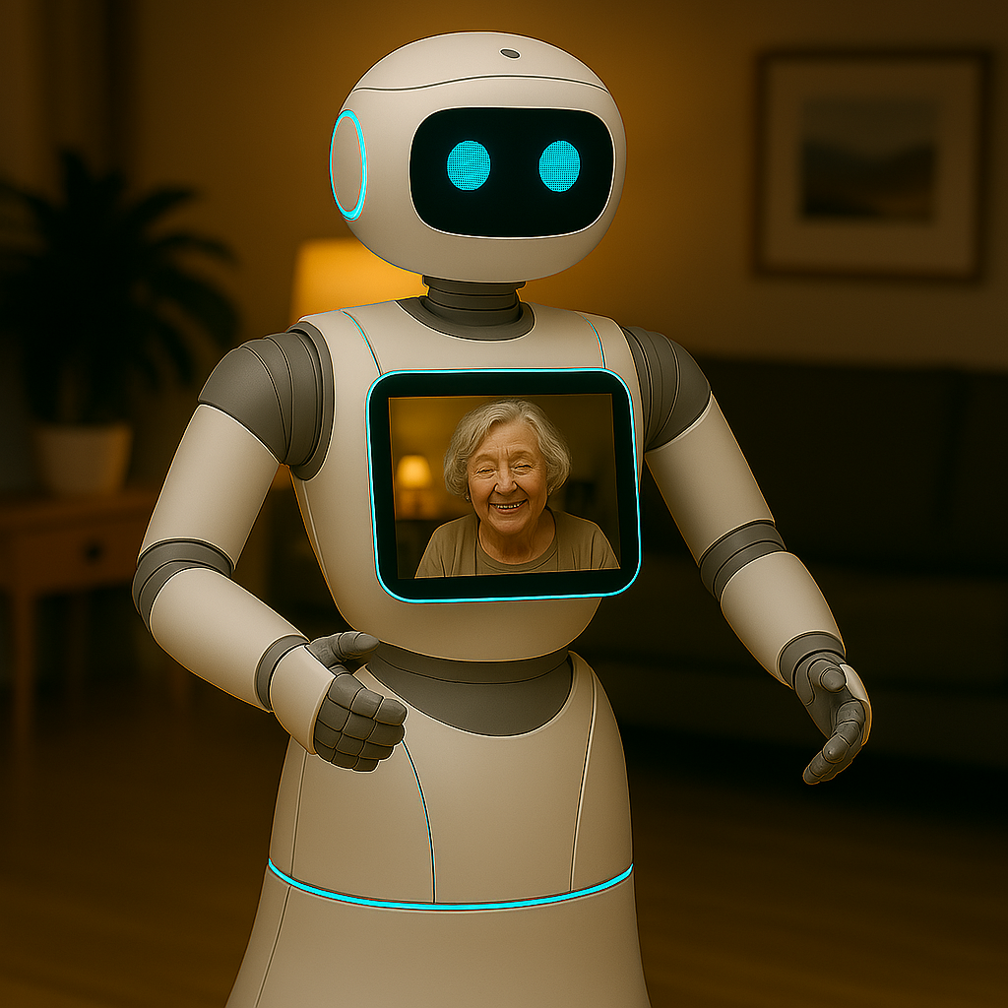
Create a welcoming image of a Smart Companion in a senior’s home with image of the senior.

Slide 4
Create an image a Smart Companion providing medication assistance to a senior in her home (pls. put med on the robot’s screen)

Slide 5
Create an AI image of a senior enjoying companionship with her Smart Companion

Slide 6
Create an image of a Smart Companion assessing a senior’s blood glucose in her home.

Slide 7
Create an image of a Smart Companion administering insulin to a senior in her living room.

Slide 8
Create an image of a Smart Companion assessing and x-raying a senior after a fall in her home

Slide 9
Create an image of a Smart Companion communicating with Margaret in Dutch and include a book with tulips

Slide 10
Create an image of a Smart Companion with Margaret having a virtual visit with her family on the screen in the daytime.

Slide 11
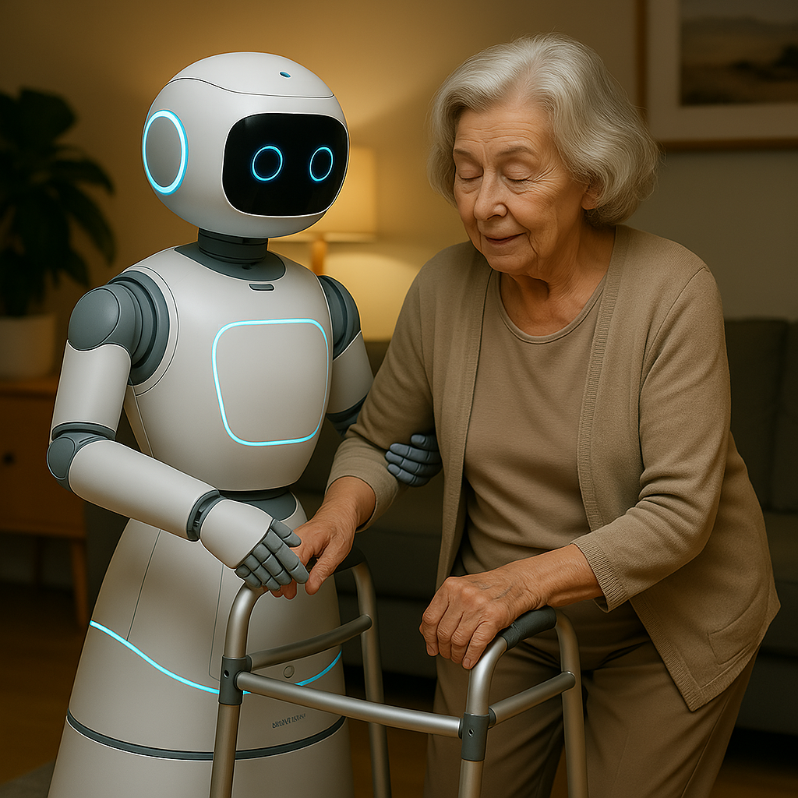
Aging in Place: Smart Companion would allow a senior to age in place and live independantly for longer (image created using this prompt)

Slide 12
$$$$
Create an image of a senior worrying about the expensive of a Smart Companion which may make them inaccessible for many seniors

Slide 13
David’s Story:
David worked as a 40-year-old project manager in Vancouver until a workplace accident two years ago left him paraplegic. Before his injury, he was fiercely independent, managing construction crews, hiking BC mountains, and living alone in his Burnaby condominium.
The transition to life with spinal cord injury has been challenging. David manages chronic pain with multiple medications and requires monitoring for pressure sores and autonomic dysreflexia, a dangerous blood pressure spike that can occur without warning. His biggest frustration is not physical limitations, but constant worry about medical emergencies when alone.
Last month, David developed an infected pressure sore that led to two weeks in hospital, something that could have been prevented with better monitoring.
Life with AIDAN
When David got AIDAN through a pilot program, everything changed. The robot monitors his skin using thermal imaging, tracks his cardiovascular health, and provides integrated smart home controls.
One morning, AIDAN detected autonomic dysreflexia during a work call, quickly identified the cause (kinked catheter), guided David through positioning changes, and contacted his healthcare team with real-time data.
Six months with AIDAN transformed David's confidence. He returned to full-time work, started dating again, and resumed adaptive sports. AIDAN's predictive analytics prevented three potential hospitalizations by catching problems early.
The robot has become David's silent partner in maintaining his professional image and personal independence, proving that medical technology can restore not just health, but dignity and autonomy.

Slide 14
Create an image of AIDAN helping a man in a wheelchair prepare for adaptive sports activities. Show AIDAN checking his equipment, monitoring his health on its display.

Slide 15
Pressure Area Checks:
Create an image of AIDAN using thermal imaging to monitor pressure points and skin integrity on a 40-year-old man in a wheelchair in his Vancouver condominium.

Slide 16
Medical Support:
Create an image of AIDAN quickly responding to an autonomic dysreflexia episode for David in his wheelchair during a video work meeting. Show AIDAN checking his catheter positioning while also displaying his vital signs on its screen, with the man's laptop showing concerned colleagues on a video call in the background.

Slide 17
Analysis Paralysis:
Create an image depicting of David feeling stressed, confused and frustrated by all the technology AIDAN offers AND a demonstrating a system failure.

Slide 18
Technology-Induced Anxiety:
Create an image of David viewing AIDAN with a worried face due to constant access to detailed health metrics which makes David hyper-aware of every small bodily change and any normal variations can trigger worry because David can see them quantified.

