Slide 1





ASSISTED-FEEDING ROBOTS IN HOSPITALS
Kulvir K. Moudgil
T00643695
Master of Nursing, Thompson Rivers University
HLTH 5500: Integrating Information Techonology in Healthcare
Dr. Anila Virani
June 13, 2025

Slide 2
OUTLINE
  Discussion about the problem of decreased nutrition intake among patients during hospitalization.
  Discussion about novel idea of assisted-feeding robots in hospitals.
  Explanation of the idea of assisted feeding through google search.
  Narration of the story regarding the assisted-feeding robots.
  AI generated pictures along with prompt including benefit and challenge related to the assisted-feeding robots.

Slide 3
Problem
  Poor nutritional intake by hospitalized patients post stroke
    Decreased nutrition intake
        Multifactorial
        For instance: cognition changes, dysphagia, mood disorders, or loneliness.
    Interventions to mitigate the impact of malnutrition in acute stroke focus primarily on nutrition supplementation or eternal feeding.
    Evidence to improve nutrition intake to support routine nutrition intake is insufficient.
    Improper nutrition -> malnutrition, weight loss, and immunity concerns.
        Approximately 20% hospitalized stroke patients shows signs of malnutrition.
(Sguanci et al., 2023; Robertson et al., 2020)
Notes:
Poor nutritional intake by hospitalized patients post stroke
Decreased nutrition intake post stroke among hospitalized patients is
Multifactorial
For instance: cognition changes, dysphagia, mood disorders, or loneliness.
Interventions to mitigate the impact of malnutrition in acute stroke focus primarily on nutrition supplementation or eternal feeding.
Evidence to improve nutrition intake to support routine nutrition intake is insufficient presently.
Improper nutrition leads to malnutrition, weight loss, and immunity concerns among hospitalized patients.
Approximately 20% hospitalized stroke patients shows signs of malnutrition.

Slide 4
Problem
    61% of hospitalized elderly patients have poor nutritional intake.
    42-56% of elderly patients maintain nutrient intakes less than basal metabolic rate while hospitalized.
    Patients could have a functional challenge when admitted to the hospital, which can impair proper nutrition intake, e.g., impeded cognition or mobility due to stroke, dementia, motor impairments, and arthritis.
    Unit staff might be short and have an increased workload.
      Unit staff, sometimes, can not prioritize feeding patients.
(Edwards et al., 2017; Heaven et al., 2012; Kulvir Moudgil, personal experience, April 21, 2025)
Notes:
Problem: Poor nutritional intake by hospitalized patients
61% of hospitalized elderly patients have poor nutritional intake.
42-56% of elderly patients maintain nutrient intakes less than basal metabolic rate while hospitalized.
Patients could have a functional challenge when admitted to the hospital, which can impair proper nutrition intake, e.g., impeded cognition or mobility due to stroke, dementia, motor impairments, and arthritis.
Unit staff might be short and have an increased workload.
Unit staff, sometimes, can not prioritize feeding patients.
Give personal life experience example

Slide 5
NOVEL IDEA-ASSISTED FEEDING ROBOTS IN HOSPITALS
  Assisted-Feeding: Needing help from another person to be able to eat.
  “Among hospitalized elderly, up to 70% require assistance, with one in three elderly acute stroke patients being dependent for eating” (Shune, 2020, para 1).
  Technology interventions, such as the utilization of Assisted-feeding Robots in hospitals, could help address the problem.
(Heaven et al., 2012; Park et al., 2020; Obi, 2025)
Notes:
Shune S. E. (2020). An Altered Eating Experience: Attitudes Toward Feeding Assistance Among Younger and Older Adults. Rehabilitation nursing : the official journal of the Association of Rehabilitation Nurses, 45(2), 97–105. https://doi.org/10.1097/rnj.0000000000000147
Heaven, B., Bamford, C., May, C., & Moynihan, P. (2012). Food work and feeding assistance on hospital wards. Sociology of Health & Illness, 35(4), 628-642. https://doi.org/10.1111/j.1467-9566.2012.01515.x
Park, D., Hoshi, Y., Mahajan, H. P., Kim, H. K., Erickson, Z., Rogers, W. A., & Kemp, C. C. (2020). Active-robot-assisted feeding with a general-purpose mobile manipulator: Design, evaluation, and lessons learned. Science Direct, 124(2020), e103344. https://doi.org/10.1016/j.robot.2019.103344
Obi. (2025). What is Obi. https://meetobi.com/?srsltid=AfmBOooUM0EJkGCtyLv8vkbhn6fN5xcaoEl7X4SNB-5_6BY5Ie_QKJwd

Slide 6
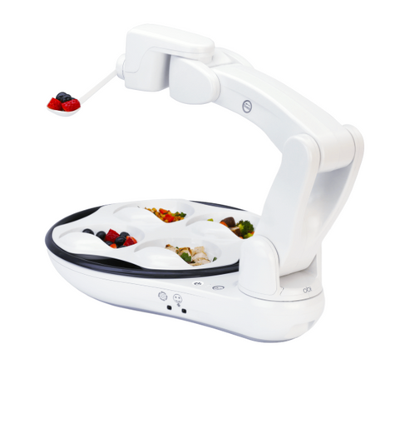
NOVEL IDEA-ASSISTED FEEDING ROBOTS IN HOSPITALS
  Assisted-Feeding Robots: A medical device intended to compensate for the function of a human arm during feeding.
    Suitable for people with any impairments that hinder meal intake.
  At present, these robots have a mobile base and human-like arms to assist people in overcoming their physical limitations.
(Heaven et al., 2012; Park et al., 2020; Obi, 2025)

Slide 7
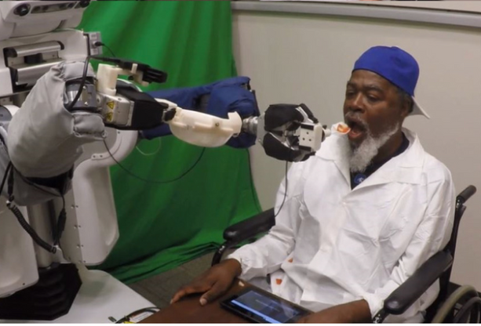
GOOGLE SEARCH
    Obi in the US: Global leader in robotic self-feeding technology.
    University of Washington: Robotic feeding assistance for people with motor impairments.
    Stanford University working on novel robotic algorithms to enhance autonomy and comfort during feeding process.
      Assisted-feeding robots restore self-feeding performance.
      Assisted-feeding robots allow people to eat what they want and when they want.
      (Obi, 2023; Miller, 2025; Park et al., 2020)
https://doi.org/10.1016/j.robot.2019.103344
Notes:
The US have taken the lead to implement the idea of assisted feeding robots with focus on people with motor impairments.
Obi. (2025). What is Obi. https://meetobi.com/?srsltid=AfmBOooUM0EJkGCtyLv8vkbhn6fN5xcaoEl7X4SNB-5_6BY5Ie_QKJwd
Miller, K. (2023). Building a precise assistive-feeding robot that can handle any meal. Stanford University. https://hai.stanford.edu/news/building-precise-assistive-feeding-robot-can-handle-any-meal

Slide 8
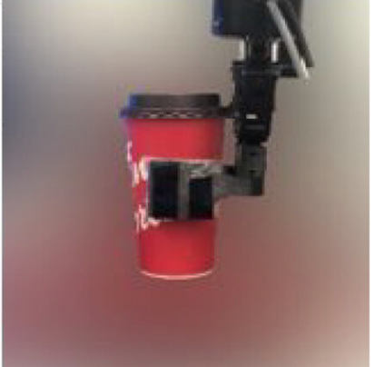
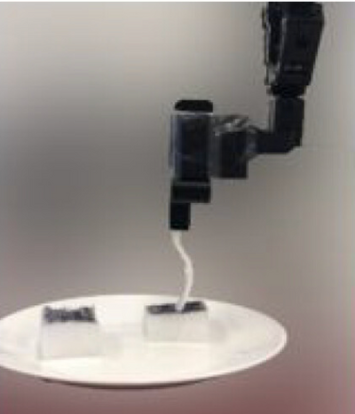
GOOGLE SEARCH
  Sweden: Bestic serves as eating assistance for patients with neurological disorders.
  Northwood Atlantic Canada is first one to implement robotic-feeders in Canada.
    Restore independence and autonomy
    Fully voice-controlled robots in addition to switch-operation
  British Columbia has not implemented the idea of assisted feeding robots yet.
  (Obi, 2023; Miller, 2025; Park et al., 2020; Medical Expo, 2025; Uhlarik, 2025 )
https://doi.org/10.1177/172988062311835
Notes:
Obi. (2025). What is Obi. https://meetobi.com/?srsltid=AfmBOooUM0EJkGCtyLv8vkbhn6fN5xcaoEl7X4SNB-5_6BY5Ie_QKJwd
Sadiq, S. (2025). People with motor impairments help develop robotic feeding assistant at University of Washington. https://www.opb.org/article/2025/03/31/think-out-loud-robotic-feeding-assistant-robotics-motot-impairments-food-disabilities-caregivers/
Uhlarik, M. (2025). Restoring mealtime independence: Robotic feeders empower people. Canadian Healthcare Technology. https://www.canhealth.com/2025/02/28/restoring-mealtime-independence-robotic-feeders-empower-people/
Mashrur T, Ghulam Z, French G, Abdullah HA. Assistive feeding robot for upper limb impairment—Testing and validation. International Journal of Advanced Robotic Systems. 2023;20(4). doi:10.1177/17298806231183571

Slide 9
GOOGLE SEARCH-Links
  United States: Obi & Robotic Feeding Assistant
    https://meetobi.com/?srsltid=AfmBOooUM0EJkGCtyLv8vkbhn6fN5xcaoEl7X4SNB-5_6BY5Ie_QKJwd
    https://www.opb.org/article/2025/03/31/think-out-loud-robotic-feeding-assistant-robotics-motot-impairments-food-disabilities-caregivers/
    https://hai.stanford.edu/news/building-precise-assistive-feeding-robot-can-handle-any-meal
  Northwood Atlantic Canada: Robot Feeders
    https://www.canhealth.com/2025/02/28/restoring-mealtime-independence-robotic-feeders-empower-people/
Notes:
Obi. (2025). What is Obi. https://meetobi.com/?srsltid=AfmBOooUM0EJkGCtyLv8vkbhn6fN5xcaoEl7X4SNB-5_6BY5Ie_QKJwd
Sadiq, S. (2025). People with motor impairments help develop robotic feeding assistant at University of Washington. https://www.opb.org/article/2025/03/31/think-out-loud-robotic-feeding-assistant-robotics-motot-impairments-food-disabilities-caregivers/
Uhlarik, M. (2025). Restoring mealtime independence: Robotic feeders empower people. Canadian Healthcare Technology. https://www.canhealth.com/2025/02/28/restoring-mealtime-independence-robotic-feeders-empower-people/
Mashrur T, Ghulam Z, French G, Abdullah HA. Assistive feeding robot for upper limb impairment—Testing and validation. International Journal of Advanced Robotic Systems. 2023;20(4). doi:10.1177/17298806231183571

Slide 10
NARRATION
Miss Allie Watson, a 40-year-old woman, was admitted to the hospital after suffering a stroke. The protocol for hot strokes was initiated, and she required hospitalization for close monitoring. Post-stroke, Allie faced significant challenges, including a right-sided deficit characterized by facial droop and weakness in her right arm.
After her transfer to the rehabilitation unit, Allie found it difficult to feed herself due to her right-sided weakness, impacting her ability to chew and manage her meals effectively. This led to frustration, particularly as her weight dropped from 65.6 kg to 61.3 kg within a week, compounded by a lack of family support. She also appeared dehydrated and weak.
During her hospital stay, Allie had a remarkable encounter with a robot named Row, which recognized her condition and introduced itself. Row supported her by bringing meal trays, providing companionship during meals, and assisting her with eating. Allie was pleasantly surprised by Row's capabilities and interaction style, which made her feel understood.
Over the nearly three months in the hospital, Allie focused on regaining her strength and adapting to her new circumstances. With Row's help, her calorie intake improved significantly, enabling her to gain weight back up to 66 kg after three months. Allie grew stronger and remained in great spirits, ultimately expressing her gratitude to Row as she prepared for discharge. She acknowledged that Row played a crucial role in her recovery, praising the technological advancements that had positively impacted her journey.
After her hospital stay, Row continued to assist Allie at home for a month to help maintain her new nutritional baseline under hospital loan program. They worked together to maintain proper calorie intake and weight at home.
The use of robots like Row in hospitals has led to notable improvements in patient outcomes, particularly among stroke victims. The introduction of assisted feeding robots resulted in a marked reduction in malnutrition rates, increased calorie intake, better weight management, fewer nasogastric tube insertions, and decreased hospital readmissions. Patients reported feeling more energized and showed greater recovery rates, highlighting the positive impact of assisted-feeding robots technology in healthcare.

Slide 11
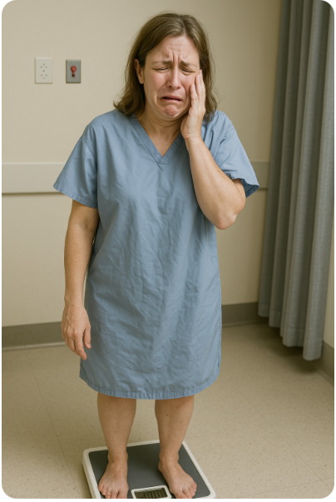
IMAGE 1
  Illustrate a weak 40-year-old woman who has suffered a stroke, exhibiting right-sided facial droop and weakness in her right arm in hospital while standing on a weighing scale, crying.
(Open AI, 2023)

Slide 12

IMAGE 2
  Illustrate a weak 40-year-old woman who has suffered a stroke, exhibiting right-sided facial droop and weakness in her right arm in hospital, visibly frustrated as she accidentally spills food from her meal tray.
(Open AI, 2023)

Slide 13
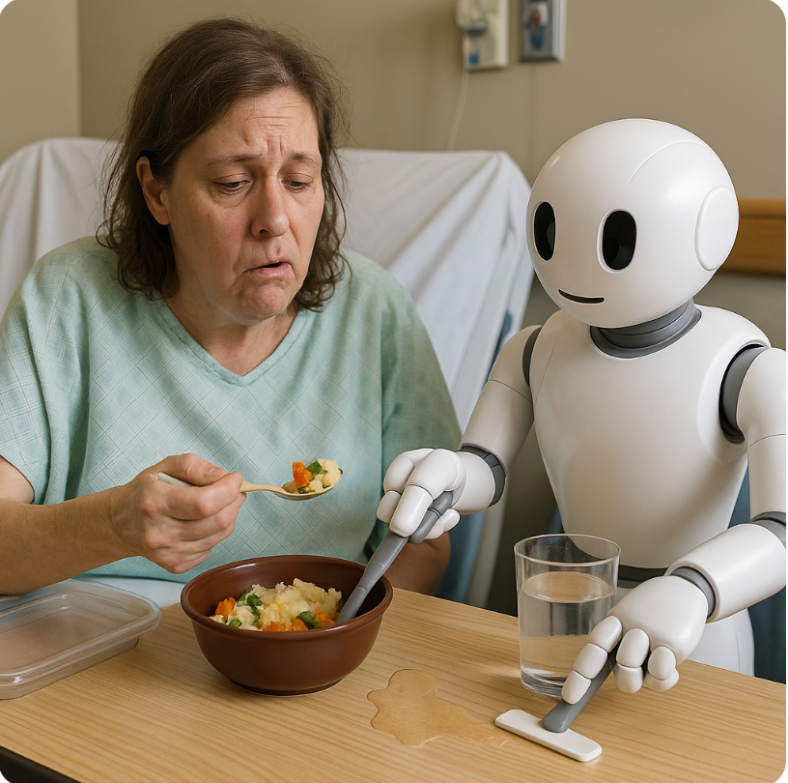
IMAGE 3
  Illustrate a weak 40-year-old woman who has suffered a stroke, exhibiting right-sided facial droop and weakness in her right arm in hospital, as she engages with an assisted-feeding robot that is cleaning up a spill and helping her eat.
(Open AI, 2023)

Slide 14
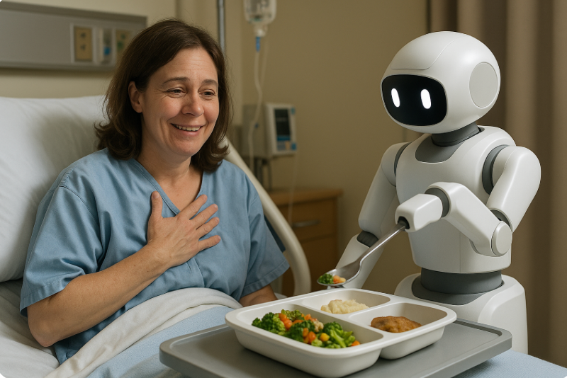
BENEFITS OF INNOVATION
  Illustrate a 40-year-old woman who has experienced a stroke, showing right-sided facial droop and weakness in her right arm, in a hospital setting as she is interacting with an assisted-feeding robot and expressing gratitude for her newfound independence to eat what and when she desires, with the robot's help.
(Open AI, 2023)

Slide 15
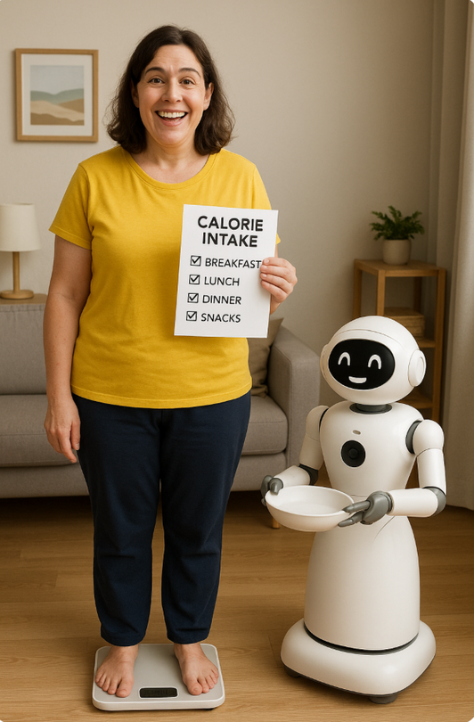
BENEFITS OF INNOVATION
  Illustrate a 40-year-old woman who has suffered a stroke, exhibiting right-sided facial droop and weakness in her right arm, in a home environment as she is standing on a weighing scale with a cheerful expression, holding a completed calorie intake checklist, with an assisted-feeding robot beside her and thankful for not having to be readmitted to the hospital.
(Open AI, 2023)

Slide 16
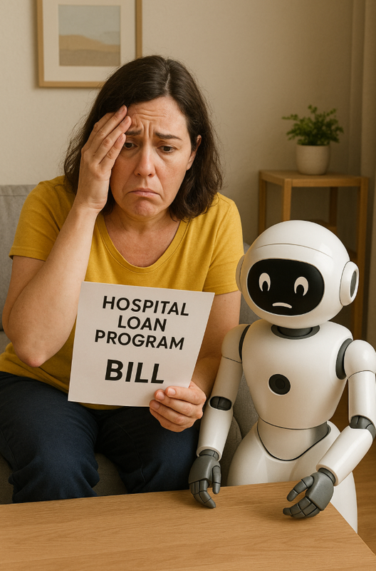
CHALLENGES WITH INNOVATION
  Illustrate a 40-year-old woman who has suffered a stroke, exhibiting right-sided facial droop and weakness in her right arm, in a home environment, sitting with an assisted-feeding robot in distress holding hospital loan program bill.
(Open AI, 2023)
Notes:
https://hai.stanford.edu/news/building-precise-assistive-feeding-robot-can-handle-any-meal

Slide 17
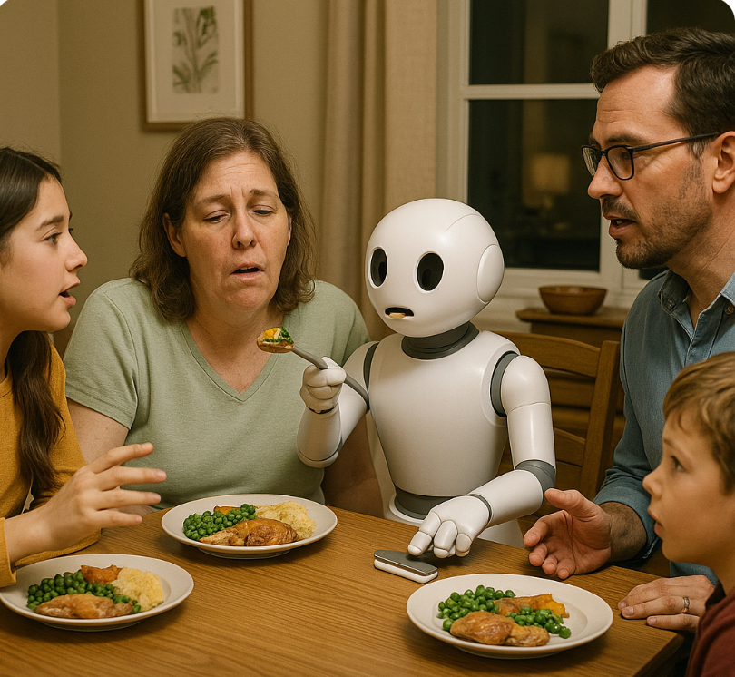
CHALLENGES WITH INNOVATION
  Illustrate a 40-year-old woman who has experienced a stroke, showing right-sided facial droop and weakness in her right arm, sitting at the dinner table in a home setting with her family, while an assisted-feeding robot is positioned between the chairs, solely focused on feeding her and interrupting the family gathering and conversations.
(Open AI, 2023)

Slide 18
REFERENCES
Heaven, B., Bamford, C., May, C., & Moynihan, P. (2012). Food work and feeding assistance on hospital wards. Sociology of Health & Illness, 35(4), 628-642. https://doi.org/10.1111/j.1467-9566.2012.01515.x
Edwards, D., Carrier, J., & Hopkinson, J. (2017). Assistance at mealtimes in hospital settings and rehabilitation units for patients (>65years) from the perspective of patients, families and healthcare professionals: A mixed methods systematic review. International Journal of Nursing studies, 69, 100–118. https://doi.org/10.1016/j.ijnurstu.2017.01.013
Mashrur T, Ghulam Z, French G, Abdullah HA. Assistive feeding robot for upper limb impairment—Testing and validation. International Journal of Advanced Robotic Systems, 20(4). https//doi.org/10.1177/17298806231183571
Medical Expo. (2025). Bestic, the eating assistance device. https://trends.medicalexpo.com/medicalexpo-e-magazine/project-118905-423917.html
Miller, K. (2023). Building a precise assistive-feeding robot that can handle any meal. Stanford University. https://hai.stanford.edu/news/building-precise-assistive-feeding-robot-can-handle-any-meal
Obi. (2025). What is Obi. https://meetobi.com/?srsltid=AfmBOooUM0EJkGCtyLv8vkbhn6fN5xcaoEl7X4SNB-5_6BY5Ie_QKJwd
OpenAI. (2023). ChatGPT (May 23 version). https://chatgpt.com

Slide 19
REFERENCES
Park, D., Hoshi, Y., Mahajan, H. P., Kim, H. K., Erickson, Z., Rogers, W. A., & Kemp, C. C. (2020). Active-robot-assisted feeding with a general-purpose mobile manipulator: Design, evaluation, and lessons learned. Science Direct, 124(2020), e103344. https://doi.org/10.1016/j.robot.2019.103344
Robertson, S. T., Grimley, R. S., Anstey, C., & Rosbergen, I. C. (2020). Acute stroke patients not meeting their nutrition requirements: Investigating nutrition within the enriched environment. Clinical Nutrition, 39(5), 1470-1477. https://doi.org/10.1016/j.clnu.2019.06.009
Sgunaci, M., Mancin, S., Piredda, M., & Marinis, M. G. (2023). Nutritional assessment in stroke a patients: A review on comprehensive evaluations across disease phases. Clinical Nutrition Open Science, 52, 151-159. https://doi.org/10.1016/j.nutos.2023.10.010
Sadiq, S. (2025). People with motor impairments help develop robotic feeding assistant at University of Washington. https://www.opb.org/article/2025/03/31/think-out-loud-robotic-feeding-assistant-robotics-motot-impairments-food-disabilities-caregivers/
Shune S. E. (2020). An Altered Eating Experience: Attitudes Toward Feeding Assistance Among Younger and Older Adults. Rehabilitation Nursing : The Official Journal of the Association of Rehabilitation Nurses, 45(2), 97–105. https://doi.org/10.1097/rnj.0000000000000147
Uhlarik, M. (2025). Restoring mealtime independence: Robotic feeders empower people. Canadian Healthcare Technology. https://www.canhealth.com/2025/02/28/restoring-mealtime-independence-robotic-feeders-empower-people/

Slide 20
THANK YOU

