Slide 1
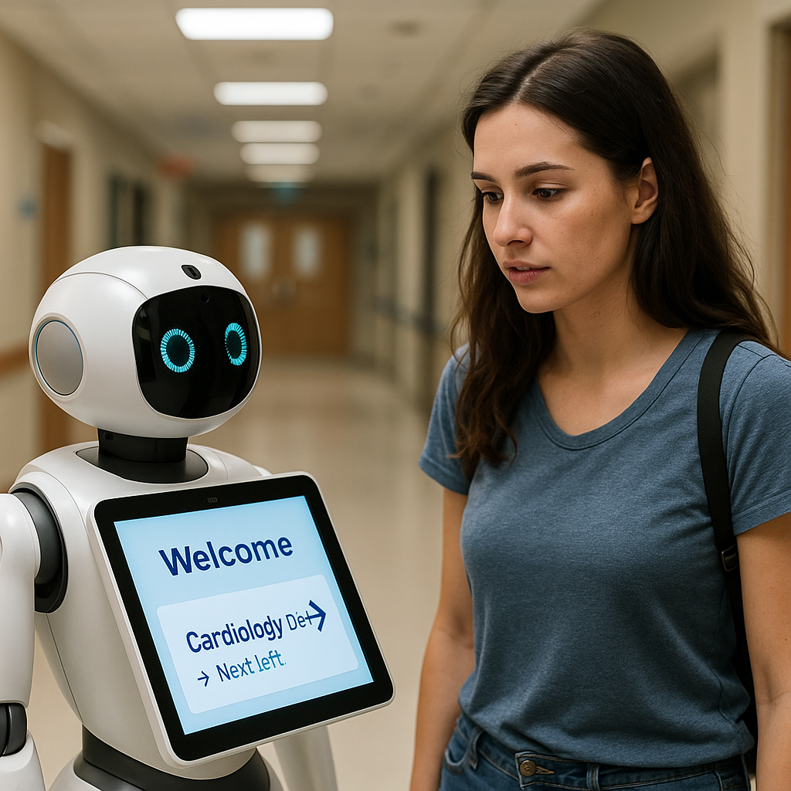
NavigateBot Wayfinding Robot

Slide 2
NavigateBot Overview
An AI-powered robotic system designed to guide patients through complex hospital layouts.
Provides multilingual, mobility-aware support for vulnerable groups.
Reduces confusion, delays, and staff workload.
Unique to BC healthcare—backed by technical design, user testing, and deployment planning.

Slide 3
Exposure to the Problem
During my interview for hospital volunteering, staff shared how many patients struggle to find their way through the facility.
In the onboarding session, I spoke with peers and the trainer, who confirmed this as a daily issue.
Patients often arrive late for appointments simply because they can’t locate the right wing, department, or elevator.
Limited staff capacity makes it challenging to provide wayfinding help to every lost or anxious visitor.

Slide 4
The Identified Problem in Healthcare

Slide 5
Confusing hospital layouts, even in Royal Inland Hospital, delay care
Language barriers affect non-English-speaking patients
Lack of real-time assistance for mobility-impaired individuals
Existing tools like 811 or Telus don't support in-hospital navigation

Slide 6
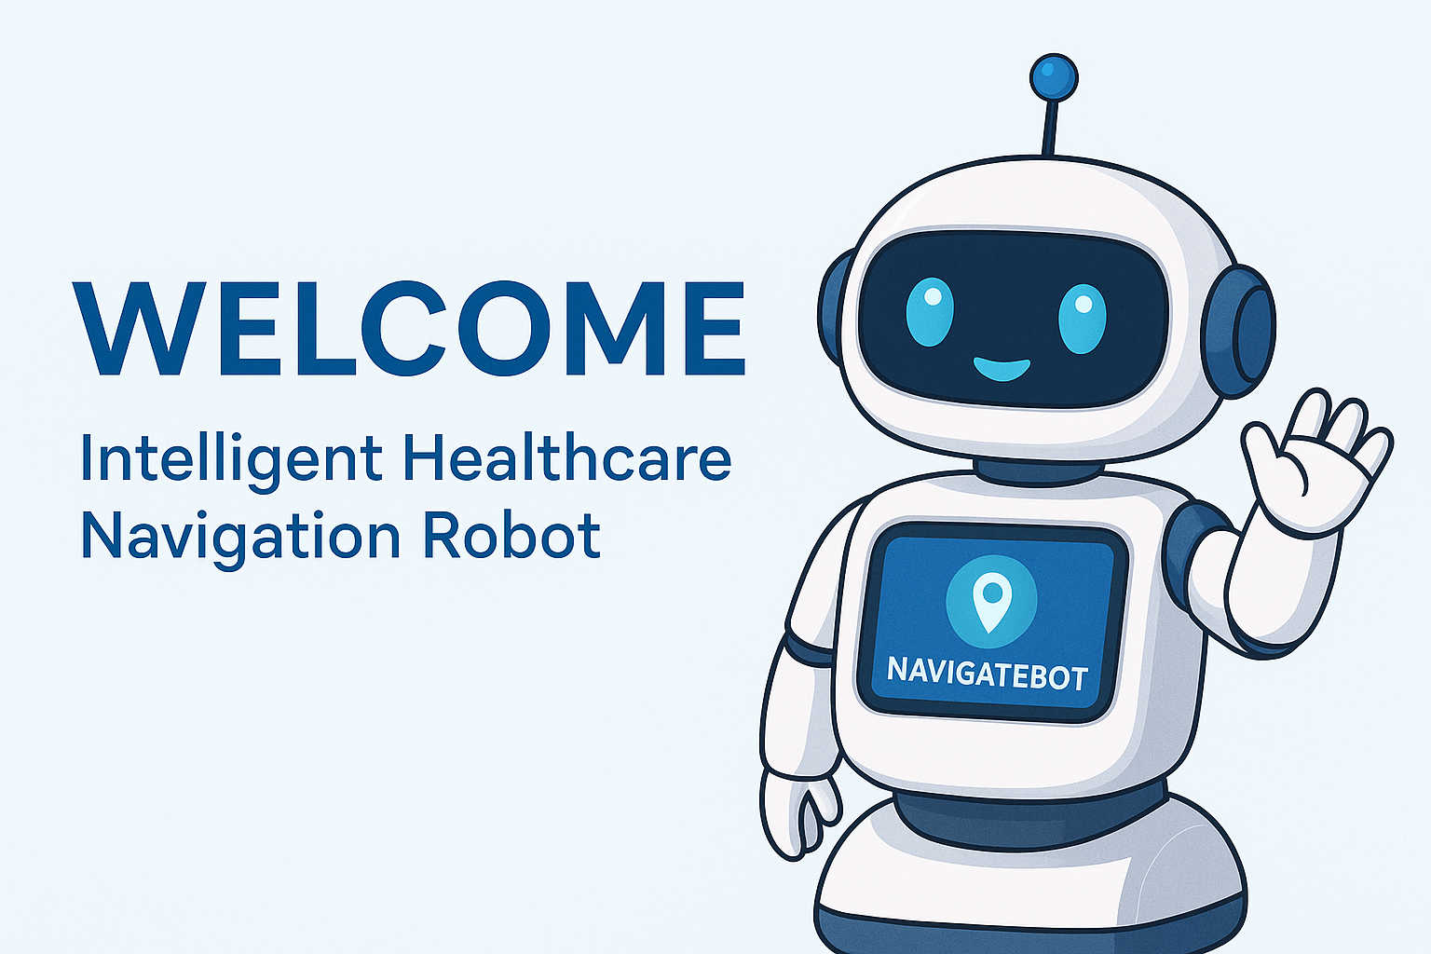
Solution :
The NavigateBot

Slide 7
Robot stationed at hospitals, clinics, and community centres
AI-driven: speaks multiple languages, prints directions, provides routing
Supports patients physically in navigating corridors, wings, and elevators
Helps reduce confusion and patient anxiety while freeing up hospital staff

Slide 8
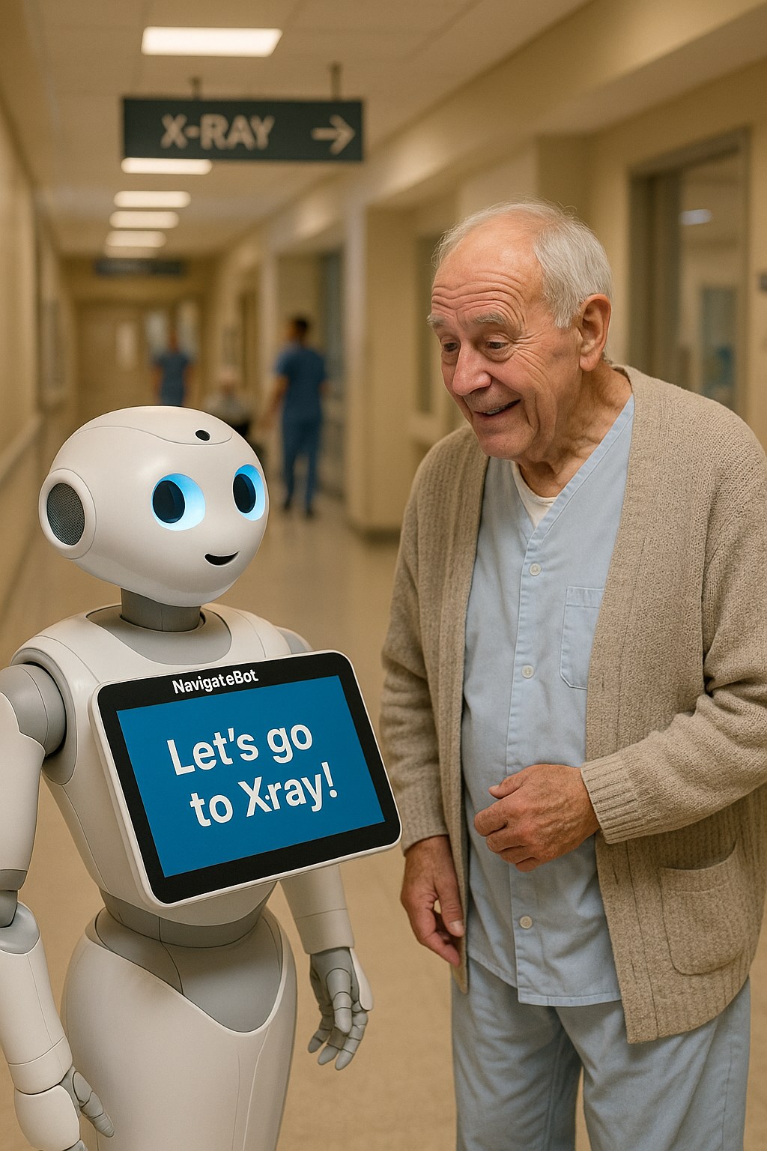
Giuseppe’s Story—Elderly Use Case

Slide 9
72-year-old Italian patient with mild cognitive decline.
NavigateBot guides him in his preferred language, Italian and guides him clearly to the right department.
Provides printed maps and directions in his language
Reduces confusion and frees up staff from needing to escort or interpret repeatedly
In BC, 1 in 5 residents is over 65, and over 30% of seniors speak a language other than English at home (Statistics Canada)—highlighting the urgent need for multilingual, senior-friendly navigation tools

Slide 10
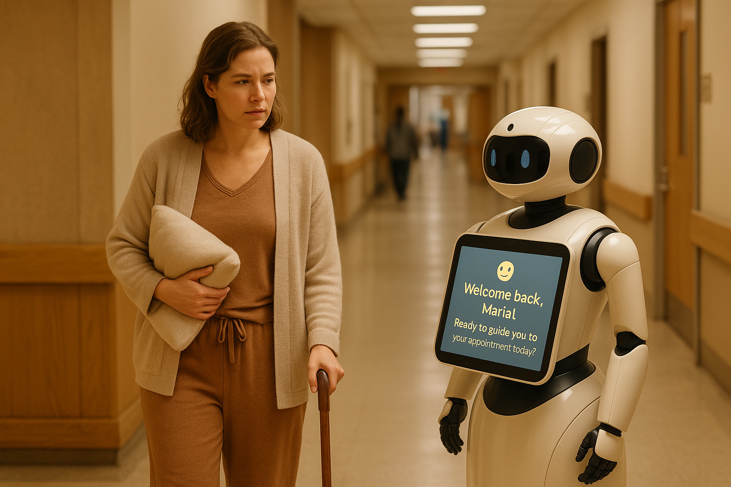
Maria’s Story—Post-Surgical Young Adult

Slide 11
30-year-old recovering from hysterectomy
NavigateBot adapts to mobility level and offers rest-stop routing
Tracks recovery, builds independence with each visit
Reduces anxiety and boosts confidence in hospital settings
Post-surgical fatigue often impacts short-term memory and focus, making it harder for patients to process complex signage or directions without support (Post-Surgical Patient Experience Study, 2025)

Slide 12
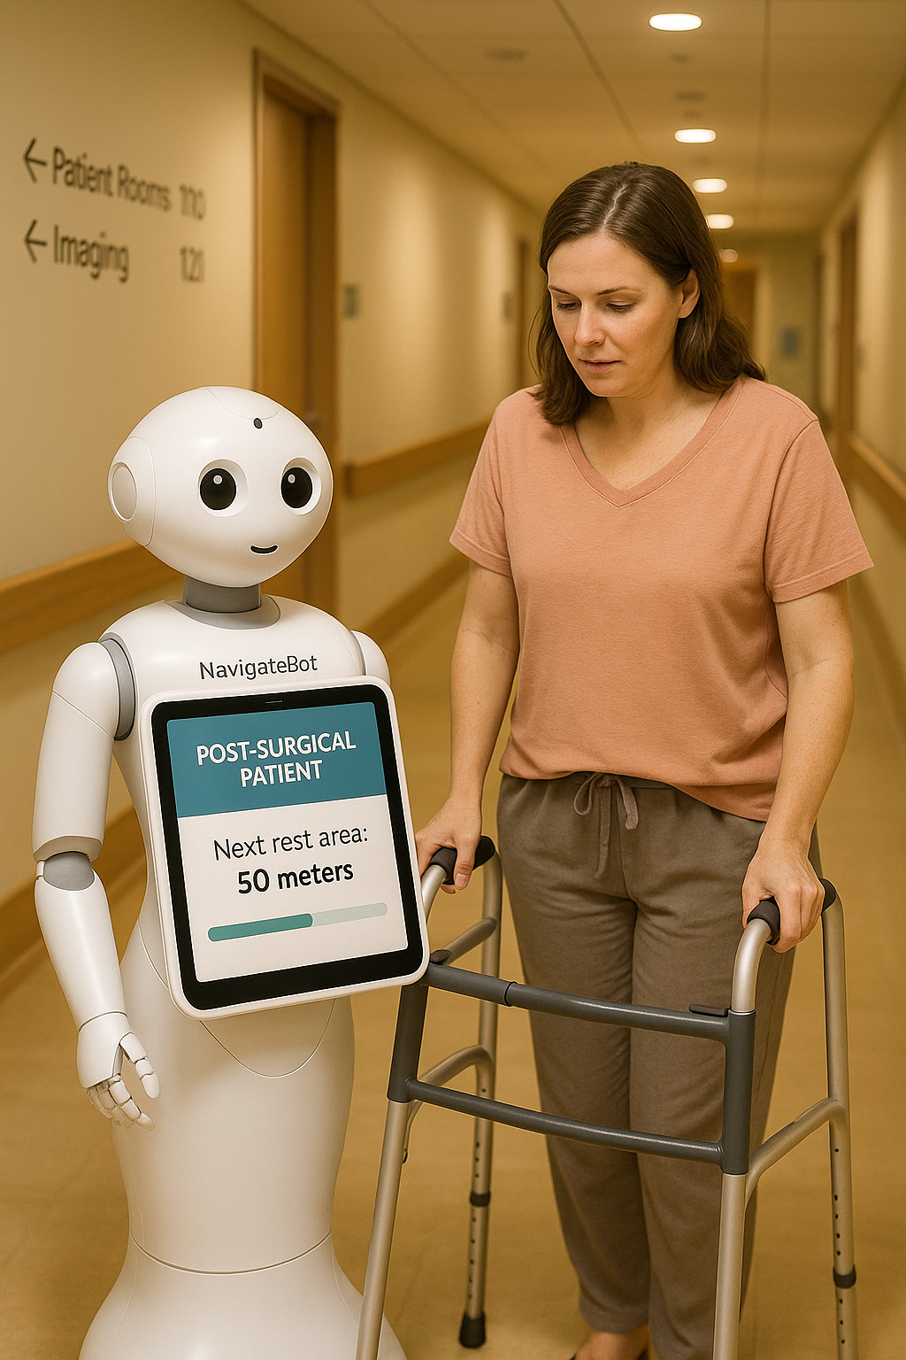
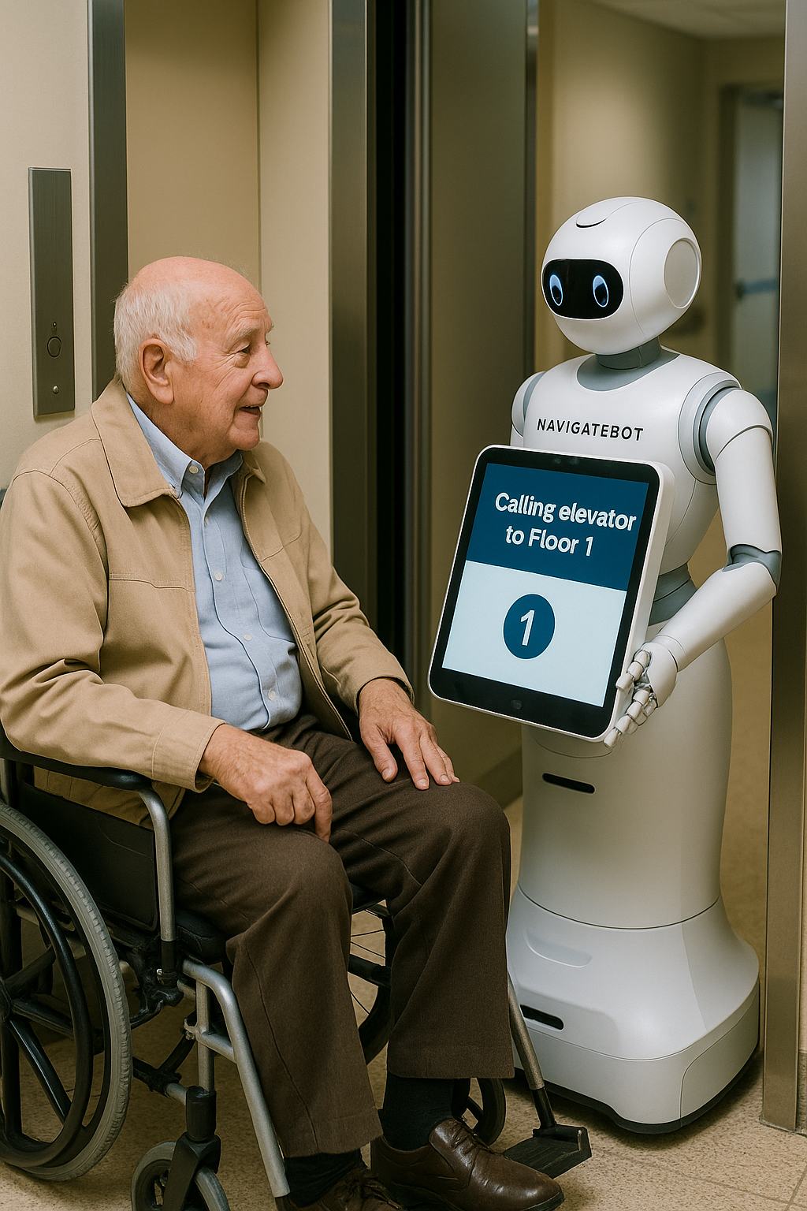
Benefits

Slide 13
Stress reduced by 89% for post-surgical patients (Post-Surgical Care Navigation Institute 2025 Study)
Multilingual routing (Punjabi, Mandarin, Italian, etc.)
Personalized, mobility-aware directions with rest stops

Slide 14
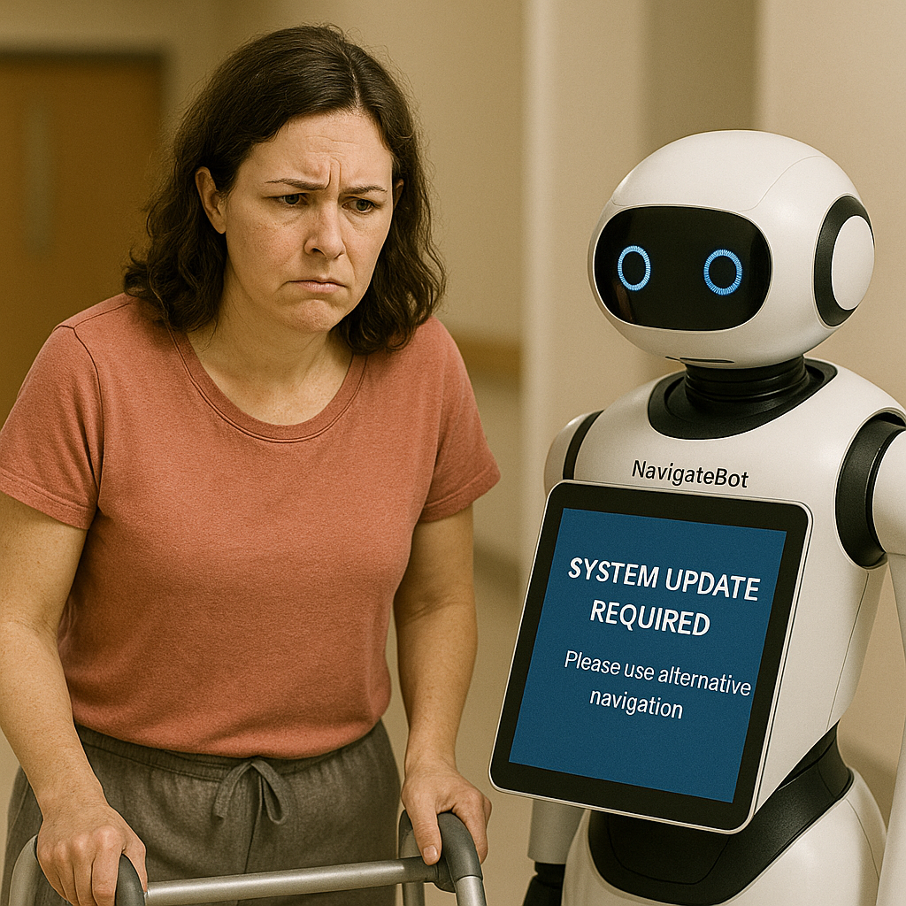
Challenges—Key Highlights
Robots average 4.2 hrs/week of downtime for updates (Healthcare Robotics Reliability Study, 2025).

Slide 15
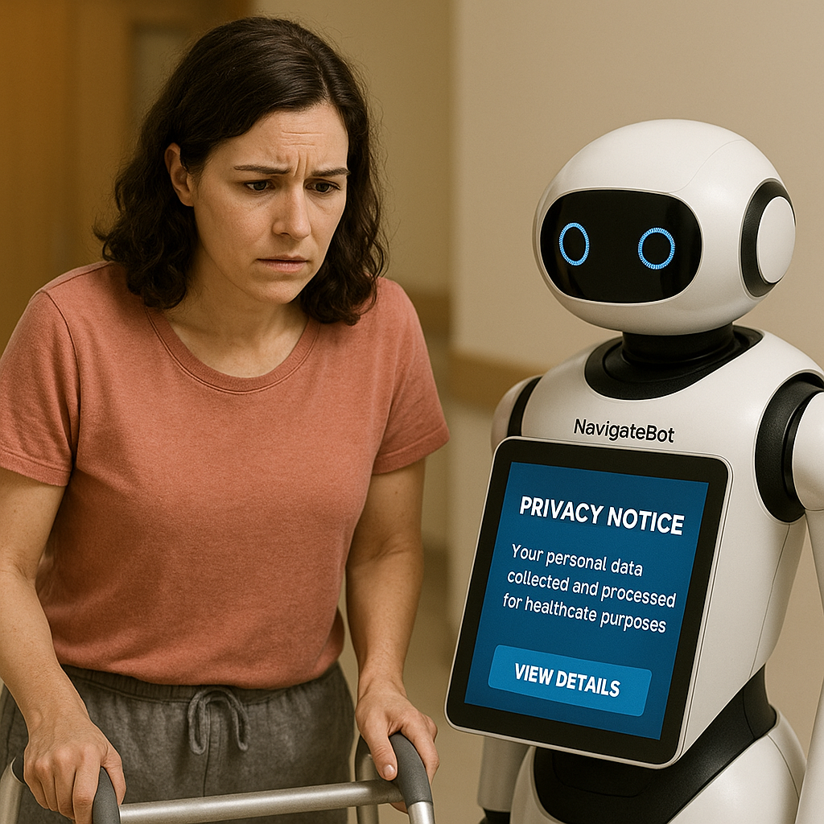
67% of users worry about data privacy (Healthcare Privacy and Robotics Institute, 2025).

Slide 16
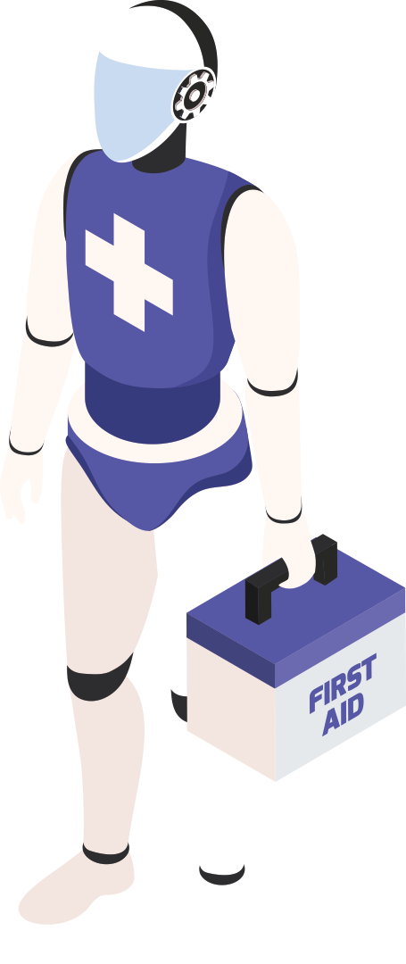
NavigateBot Supports Healthcare Staff

Slide 17
Reduces non-clinical tasks for nurses and admin staff
Allows professionals to focus more on direct patient care
Not designed to replace jobs—acts as a tool to improve workflow and reduce burnout
Encourages efficiency and team support
In BC, over 60% of nurses report burnout due to workload and task overload (Canadian Nurses Association). NavigateBot helps by reducing routine interruptions and directional support burdens

Slide 18
Why NavigateBot Stands Out
Physical robot presence: comforting for elderly and tech-hesitant users
More than a kiosk—dynamic, interactive, empathetic support
Scalable to malls, government offices, and public services

Slide 19
Conclusion
NavigateBot enhances care access, user dignity, and digital inclusion
Supports BC’s health strategy and offers 567% ROI (Fraser Institute)
A promising step in Canada’s healthcare navigation future

Slide 20
