Slide 1


NeoCuddleBot: Robotic
Soothing Unit for NICU
Infants
Sophie Bibault

Slide 2
Problem in NICUs
  Premature infants often lack consistent human touch
  Touch deprivation is linked to delayed brain development
  Many infants are too medically fragile to be held
  Nurses face time constraints for prolonged contact

Slide 3
Why Touch Matters
  Skin-to-skin contact supports brain and emotional development
  Improves heart rate, temperature regulation, and sleep
  Early tactile care leads to stronger long-term outcomes
  Human contact is beneficial but hard to deliver consistently

Slide 4
Impact on Parents
  Mothers often experience anxiety and depression in NICU
  Inability to hold their baby disrupts natural bonding
  Physical closeness reduces stress for both baby and parent
  Emotional distress can affect the family’s well-being

Slide 5
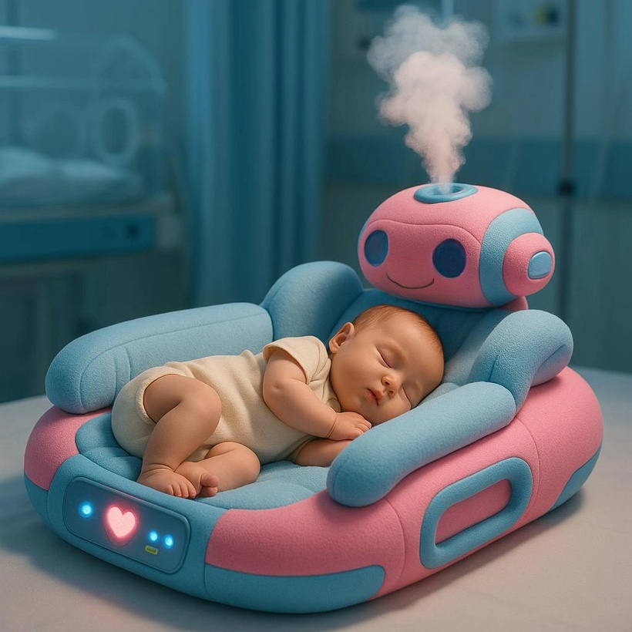
Meet the NeoCuddleBot
  Soft, AI-enabled pad designed for premature infants
  Simulates heartbeat, warmth, breathing, and scent
  Adjusts stimulation based on baby’s real-time data
  Safe and personalized for even the most fragile babies

Slide 6
Benefits of the NeoCuddleBot
  Delivers calming touch when holding isn’t possible
  Promotes brain development and emotional regulation
  Maintains infant-parent bond with scent personalization
  Supports nurses by reducing emotional load

Slide 7
Why It Matters for Hospitals
  No Canadian hospital currently uses AI cuddle technology
  Promotes faster growth and earlier discharge
  Eases pressure on staff while improving infant care
  Benefits families, hospitals, and the healthcare system

Slide 8
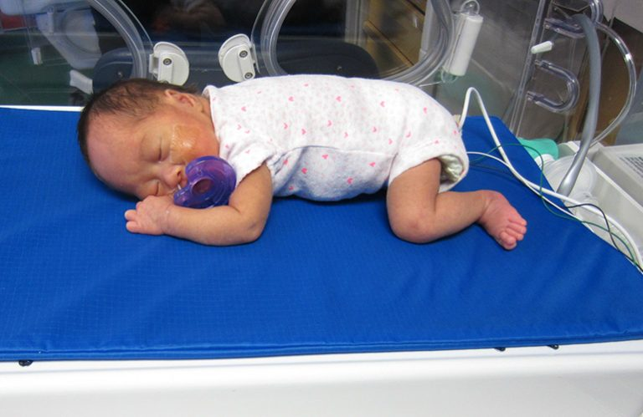
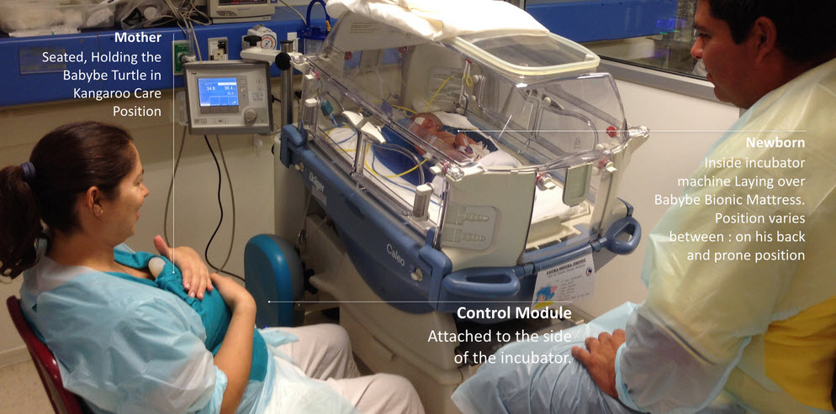
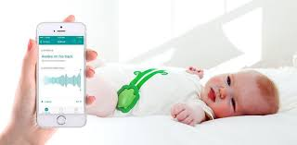
Similar Technologies
Calmer (Canada): Mimics breathing during painful procedures
Babybe (Chile): Sends mother’s voice and heartbeat to baby
  None offer full AI feedback + scent + tactile integration
Mimo Baby (USA): Tracks sleep and vitals, not NICU-specific

Slide 9
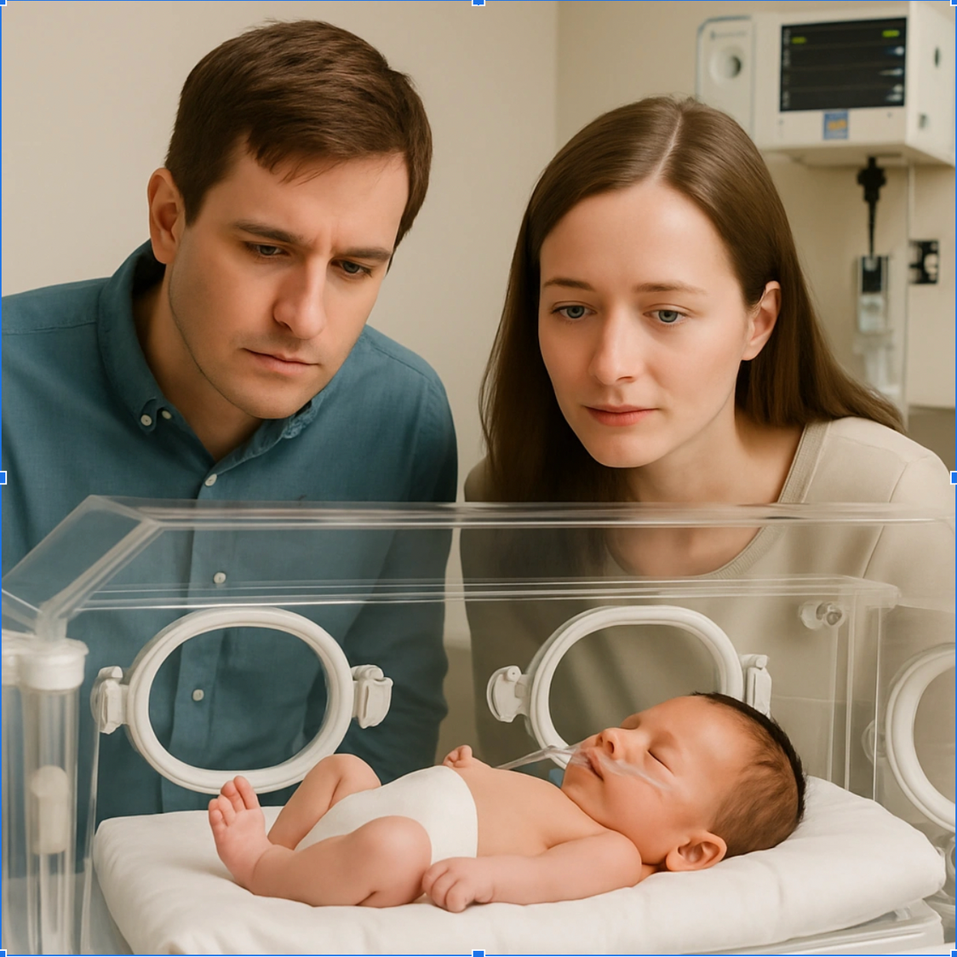
Story of Lily

Slide 10
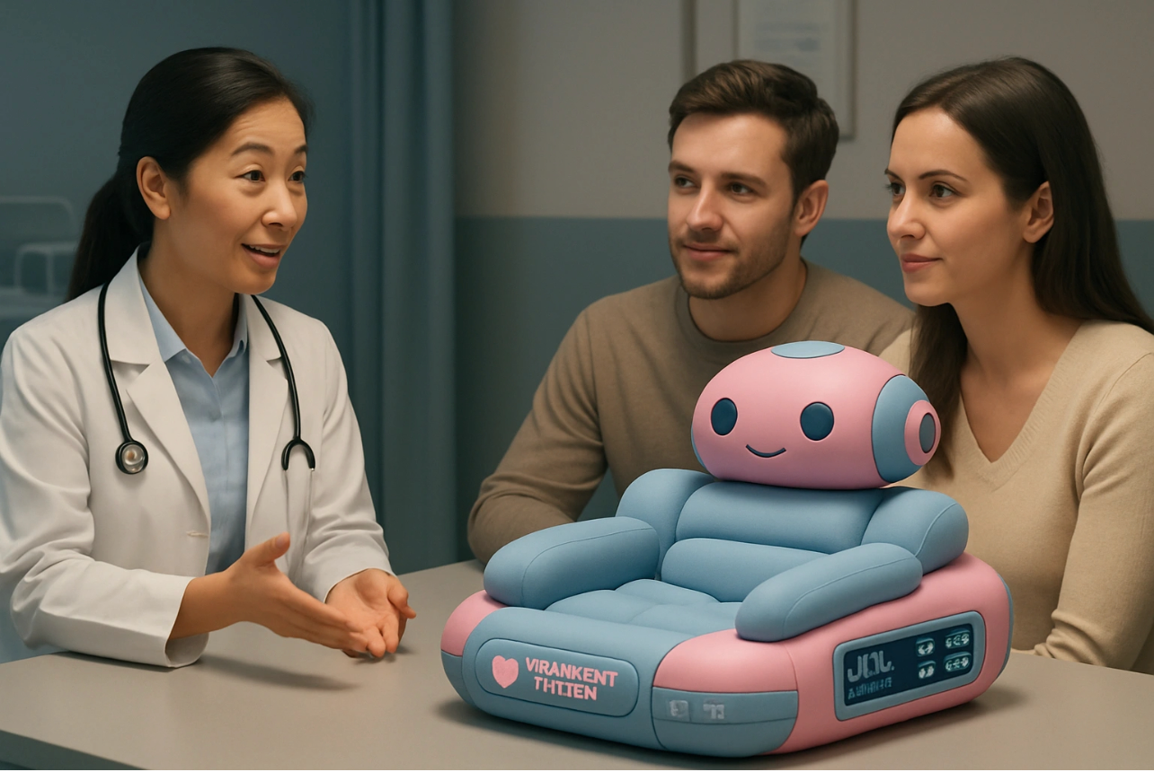

Slide 11
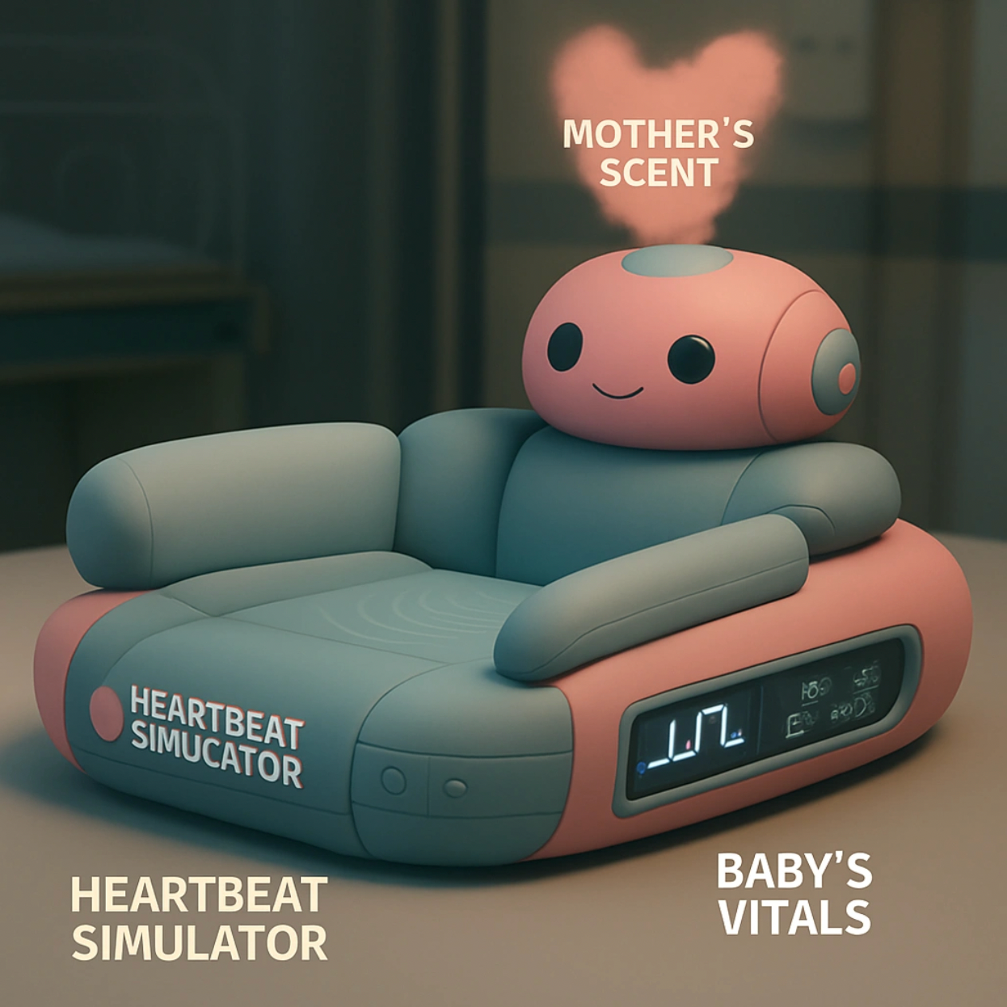

Slide 12
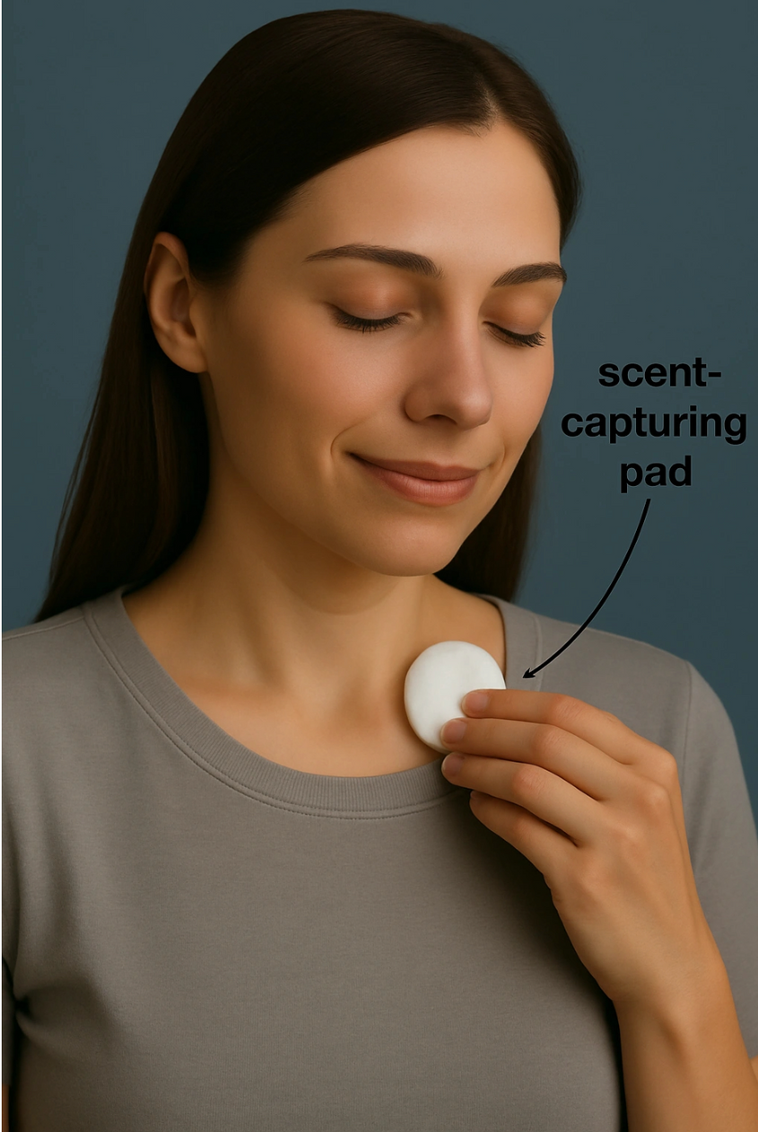

Slide 13
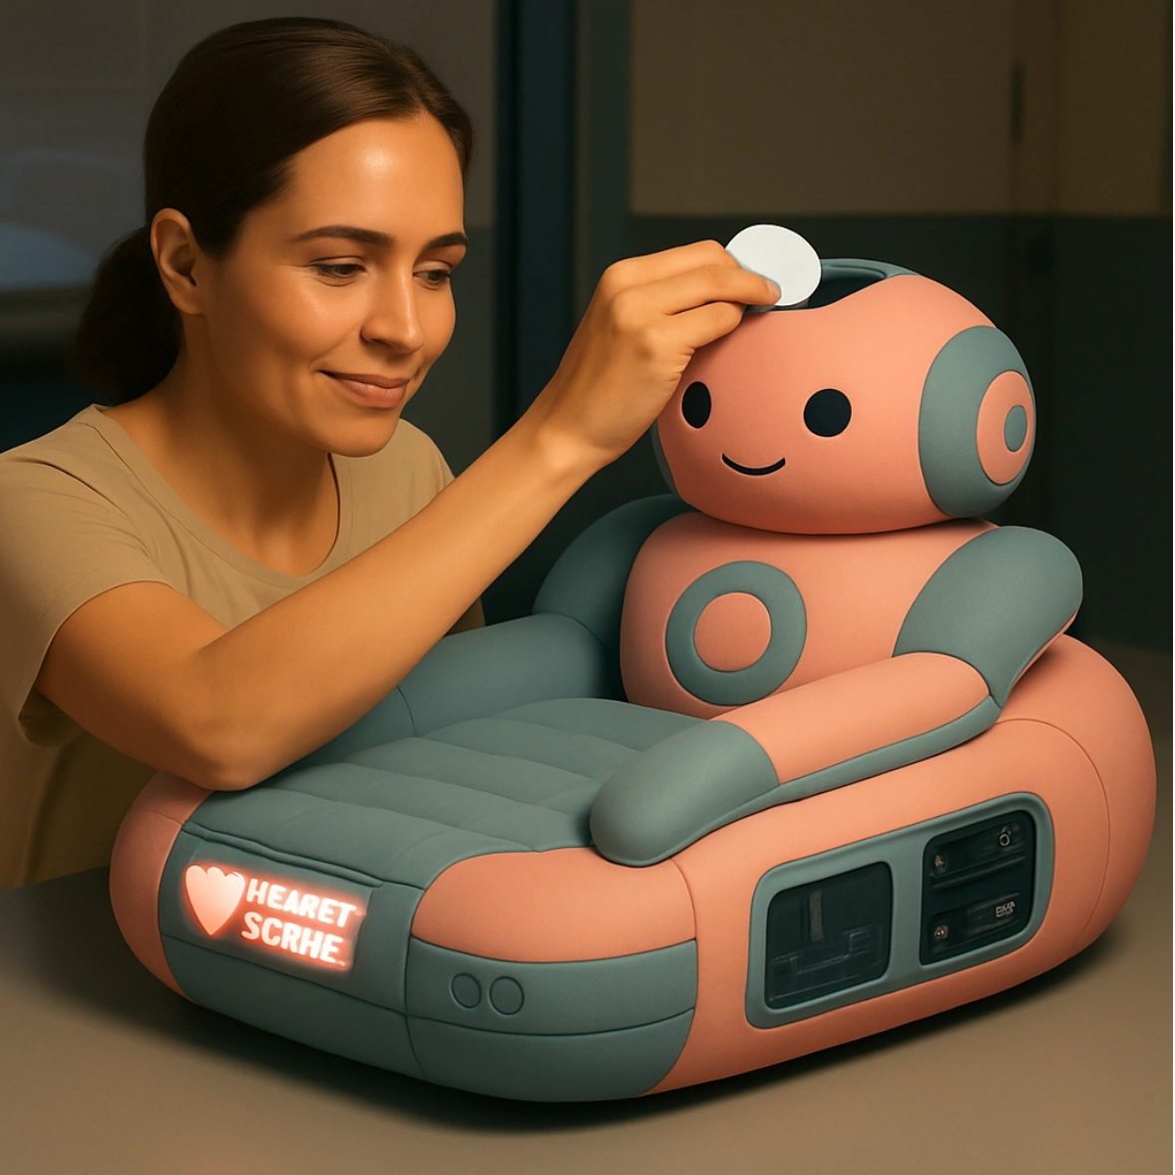

Slide 14
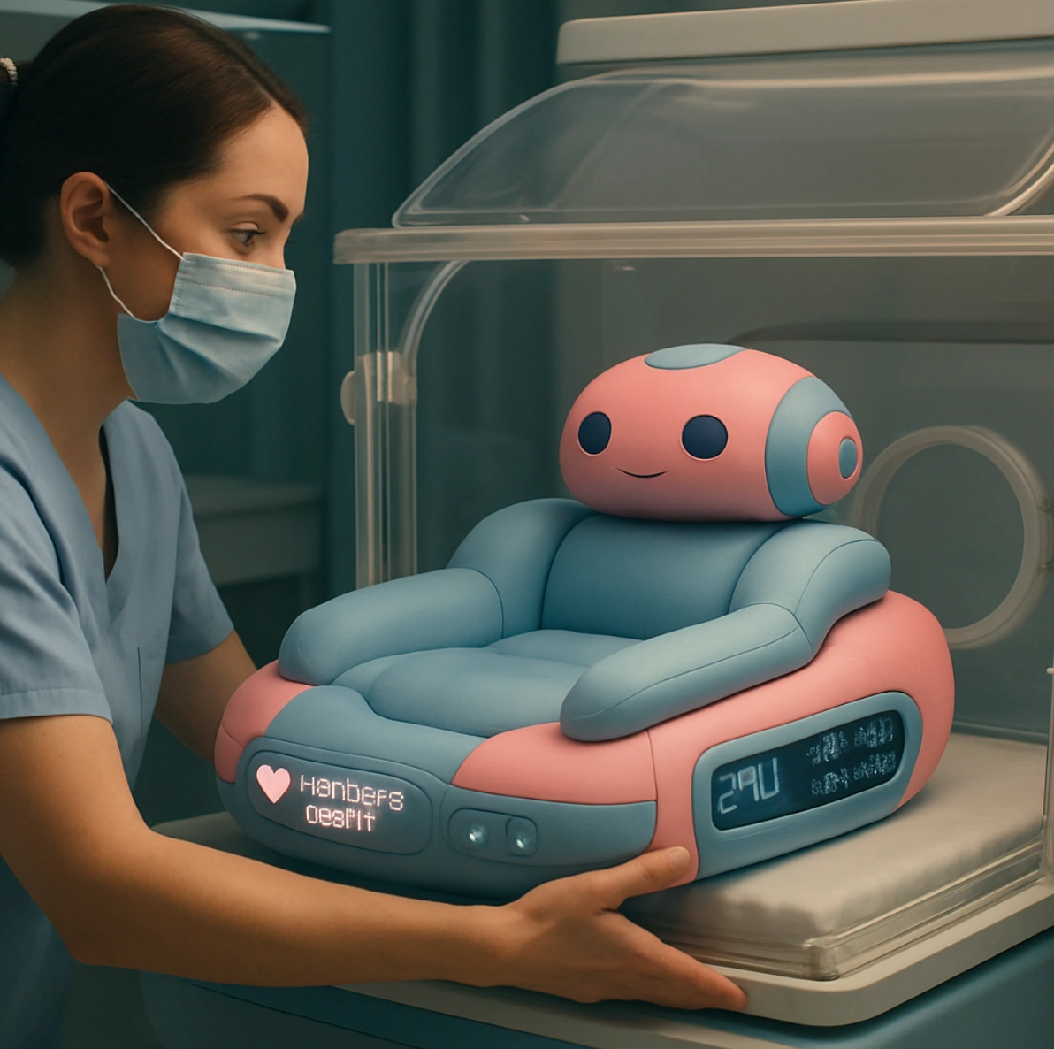

Slide 15
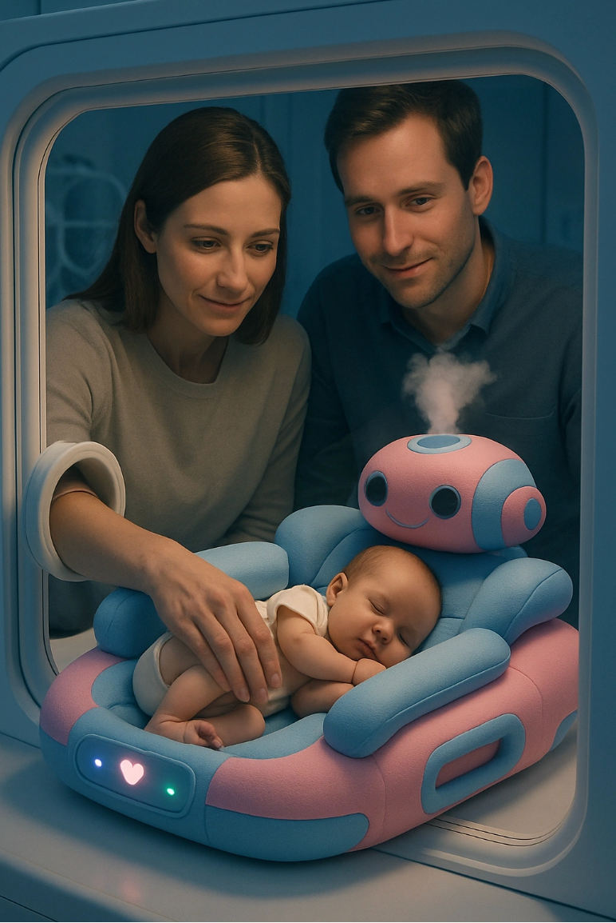

Slide 16
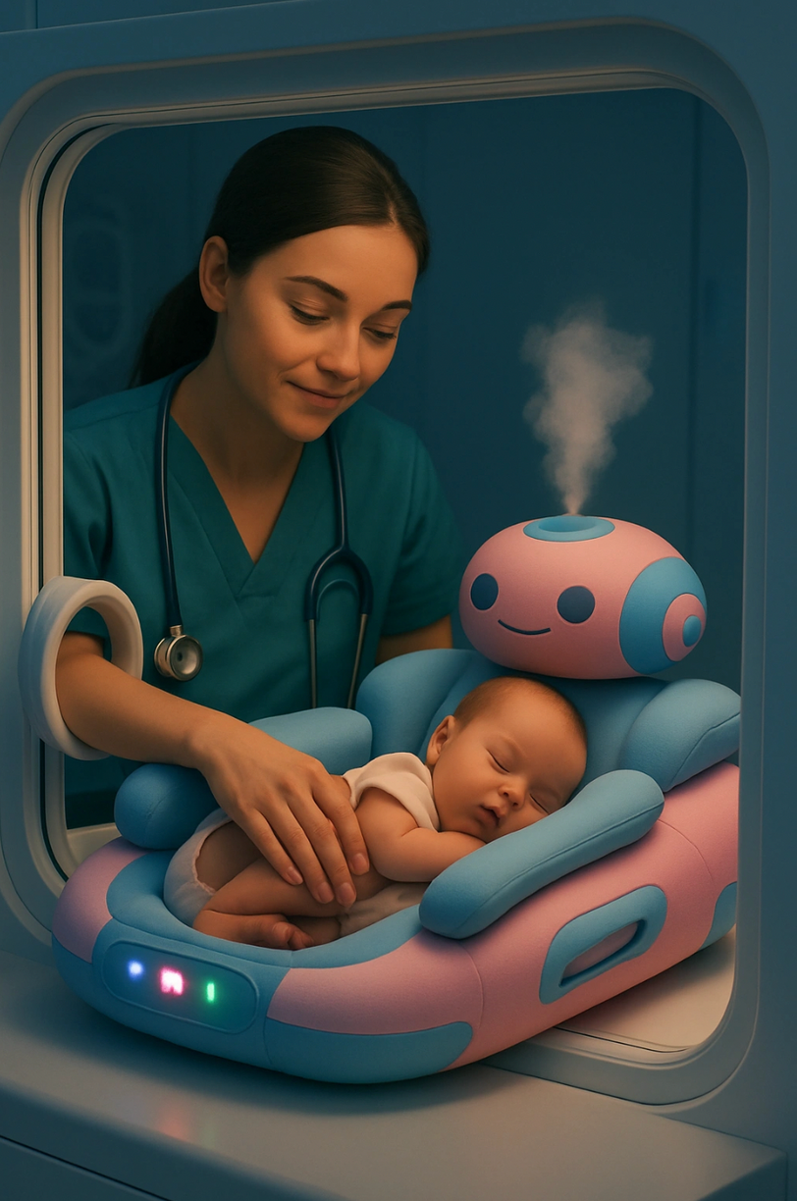

Slide 17
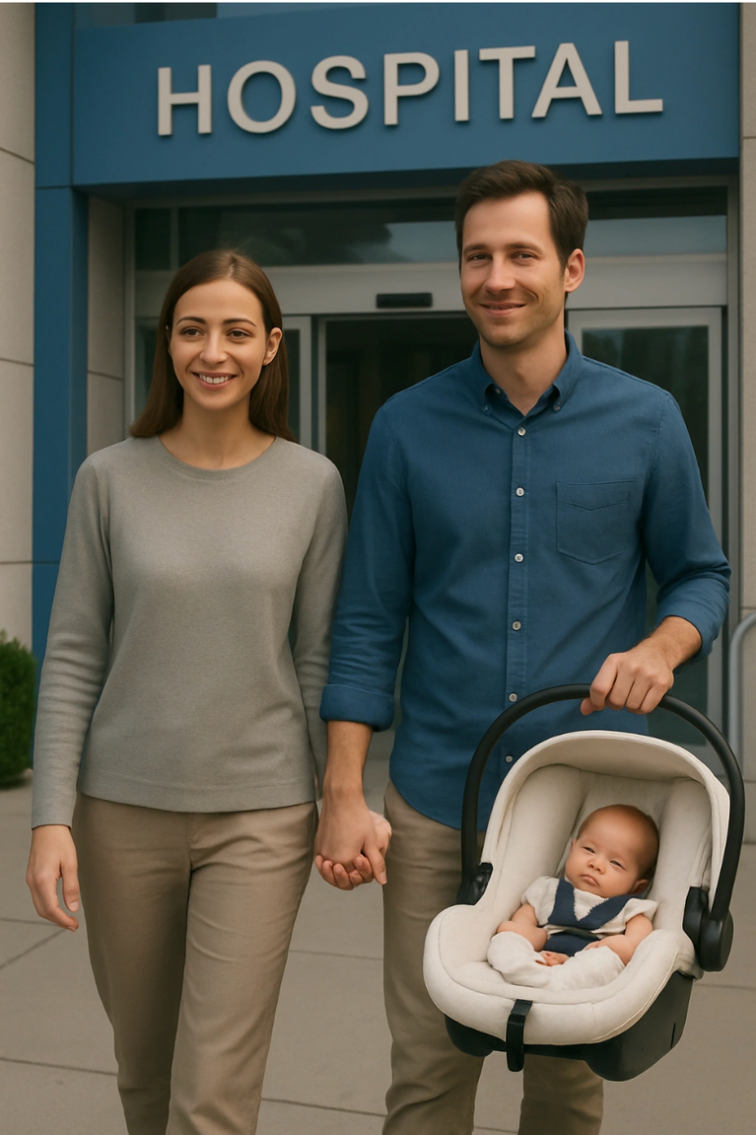
Benefit: Families being able to leave the hospital ealry

Slide 18
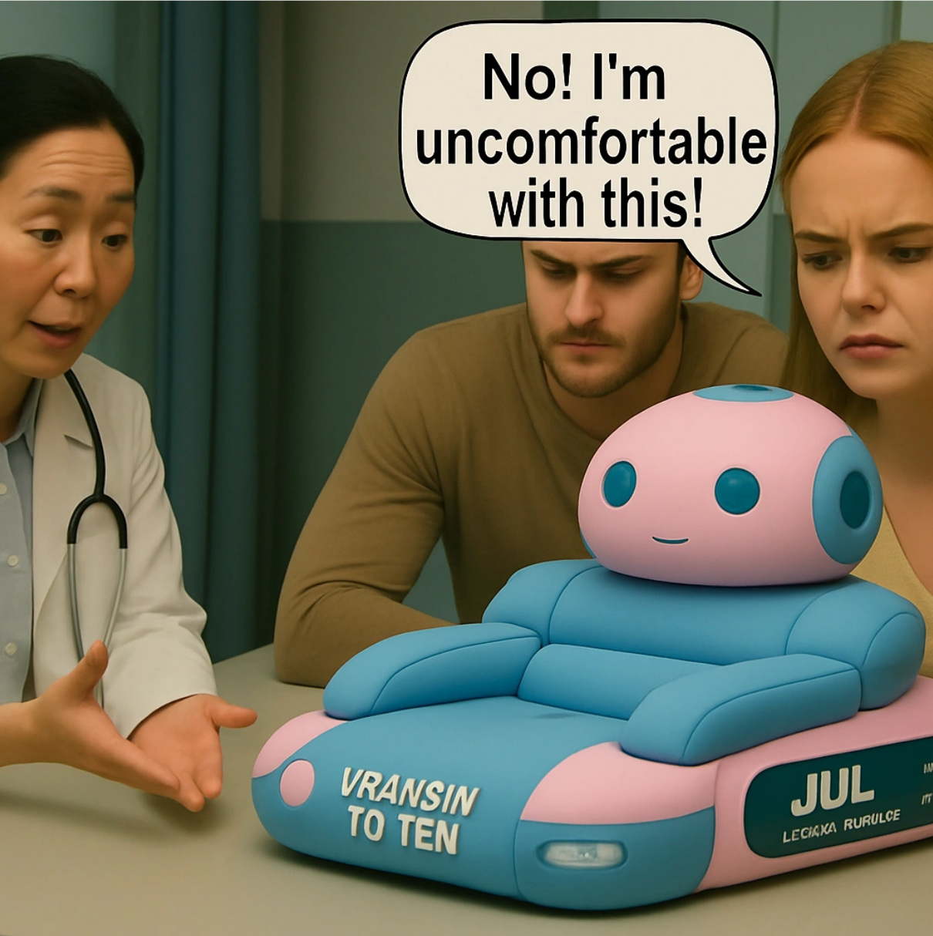
Challenge: Parent uncomfortability

Slide 19
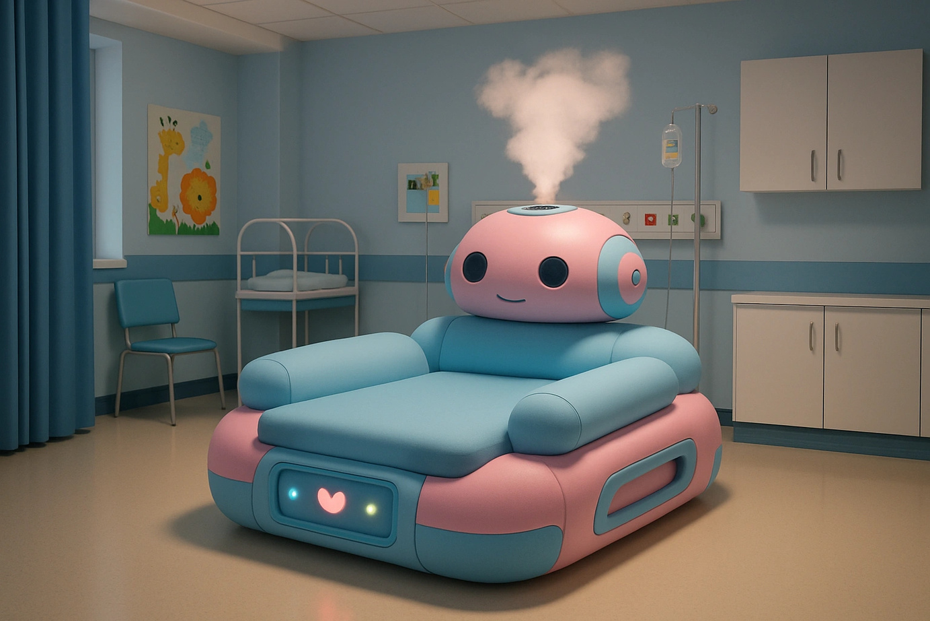
Robotic Soothing Unit for Immunocompromised Children

Slide 20
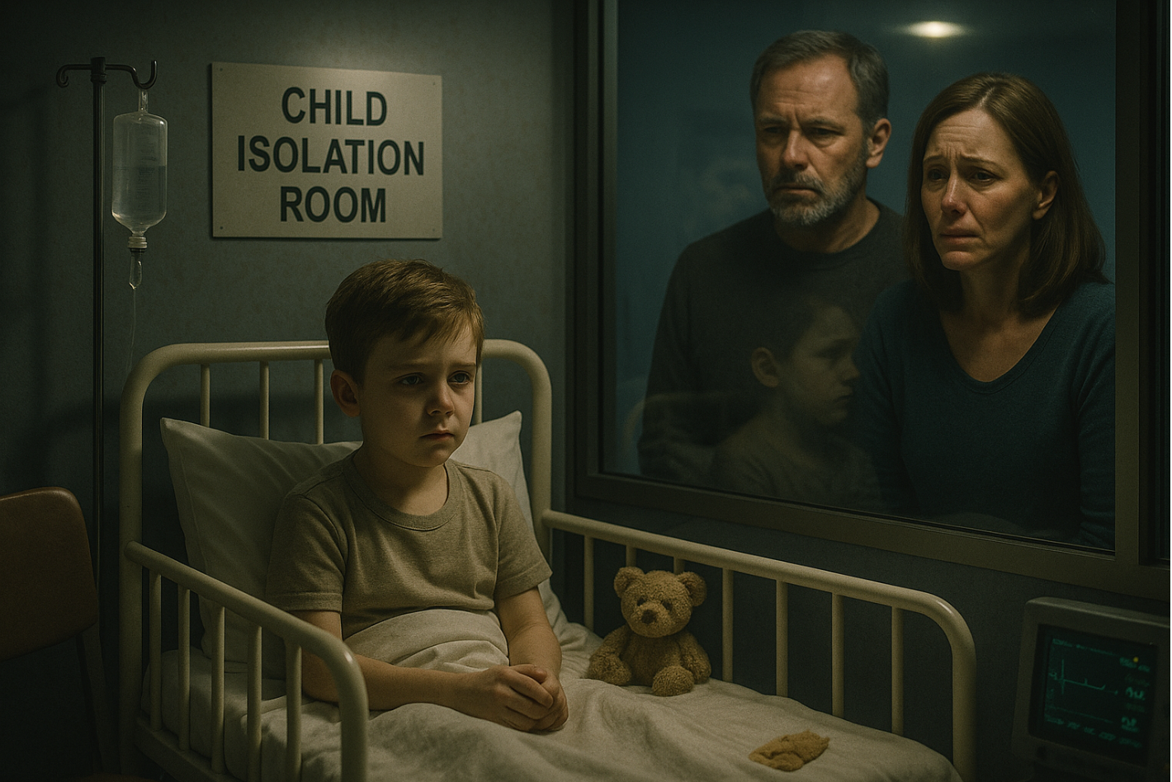

Slide 21
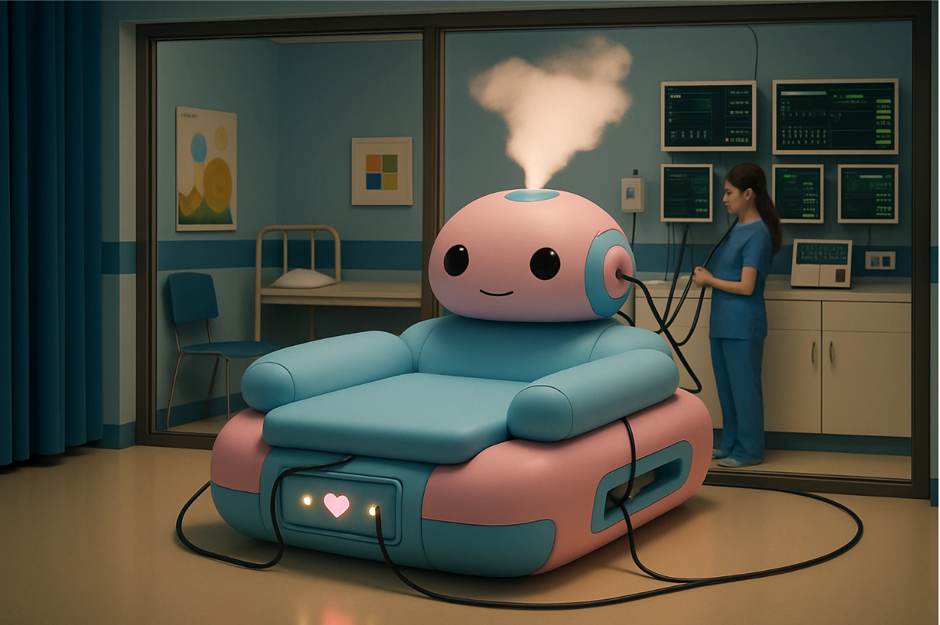
Benefit: Real-time vital tracking straight from the device

Slide 22
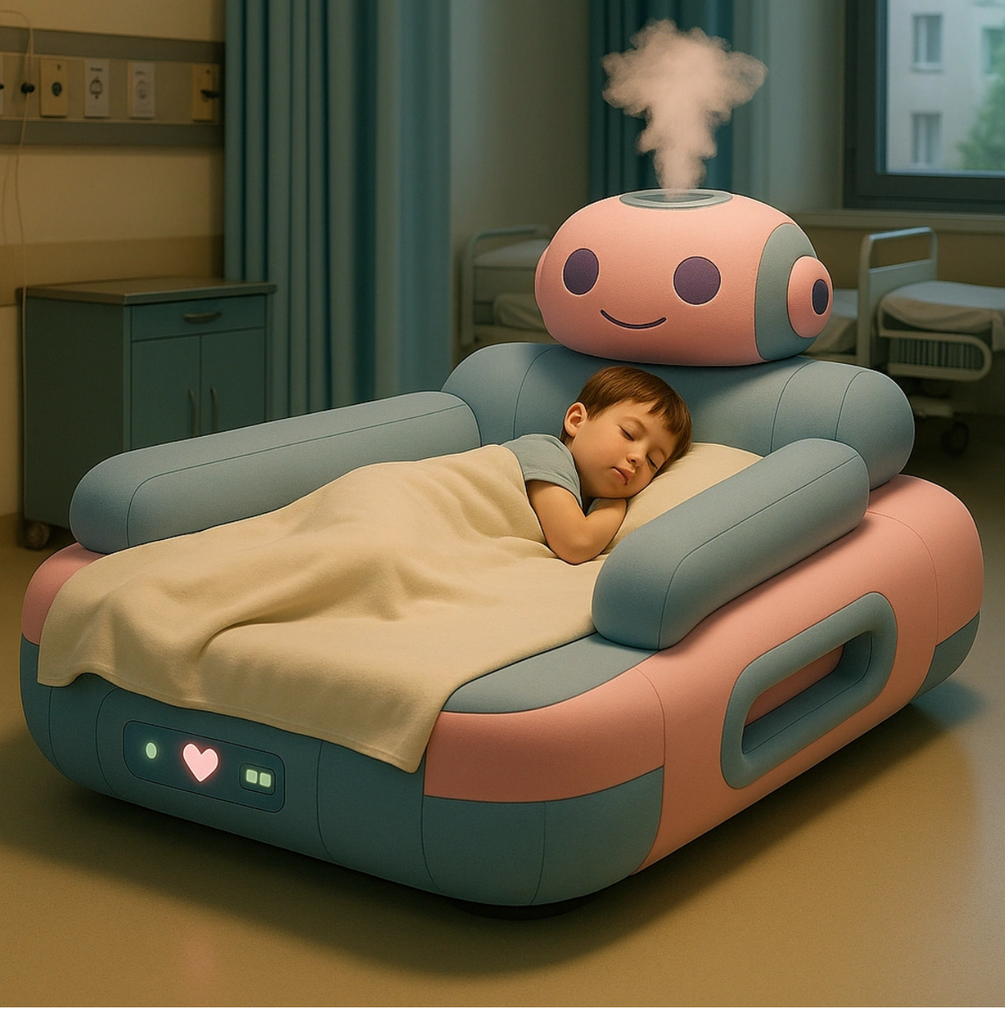
Benefit: Soothing Immunocopromised Children

Slide 23
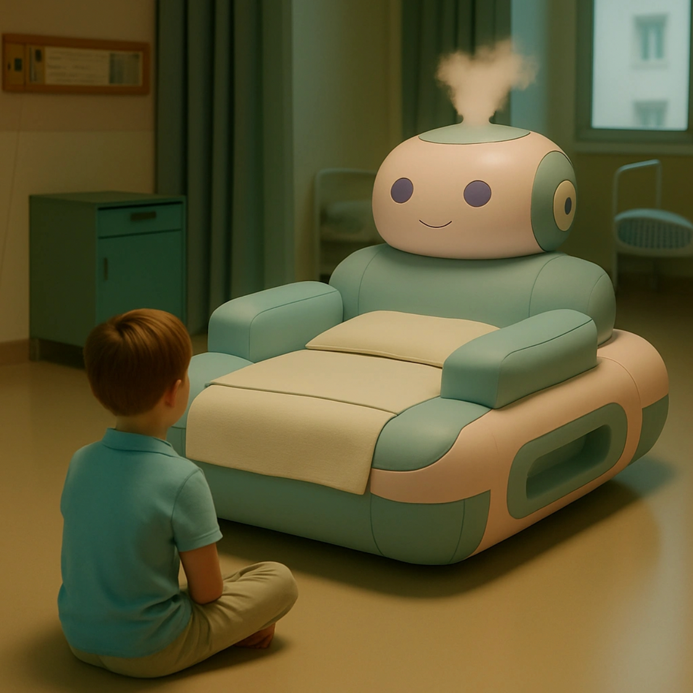
Challenge: Discomfort felt by children toward the device

Slide 24
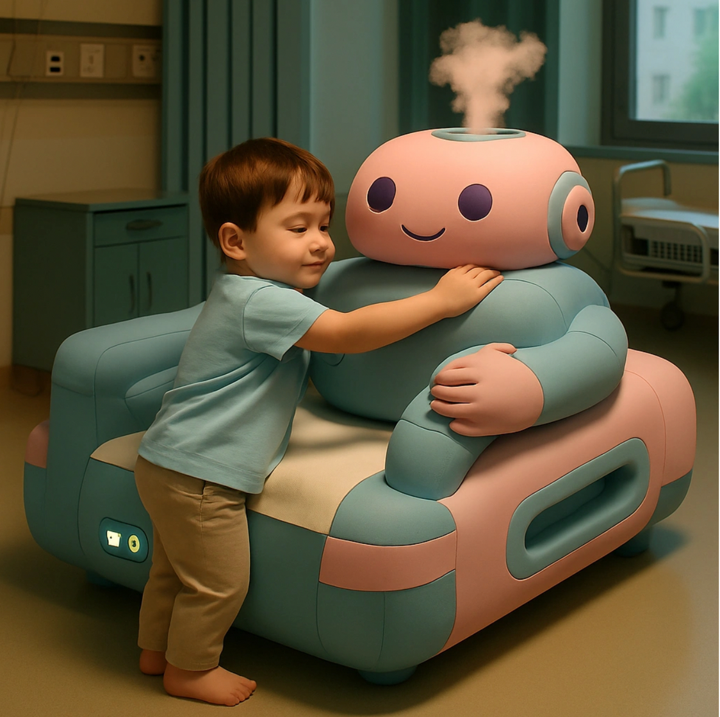
Challenge: Children becoming too attached

Slide 25

References
Conde-Agudelo, A., Díaz-Rossello, J. L., & Belizán, J. M. (2016). Kangaroo mother care to reduce morbidity and mortality in low birthweight infants. Cochrane Database of Systematic Reviews, (8), CD002771. https://doi.org/10.1002/14651858.CD002771.pub4
Feldman, R., Eidelman, A. I., Sirota, L., & Weller, A. (2002). Comparison of skin-to-skin (kangaroo) and traditional care: Parenting outcomes and preterm infant development. Pediatrics, 110(1), 16–26. https://doi.org/10.1542/peds.110.1.16
Field, T. (2010). Touch for socioemotional and physical well-being: A review. Developmental Review, 30(4), 367–383. https://doi.org/10.1016/j.dr.2011.01.001
Jeyaraj, P., Araki, L. N., & Chau, C. M. Y. (2022). Robot an effective pain management tool for premature babies. UBC Faculty of Medicine News. https://www.med.ubc.ca/news/robot-an-effective-pain-management-tool-for-premature-babies/
Montirosso, R., Borgatti, R., Trojan, S., Zanini, R., & Tronick, E. (2017). Affective touch and early neurodevelopment: A systematic review. Frontiers in Psychology, 8, 1261. https://doi.org/10.3389/fpsyg.2017.01261
OpenArt. (2022). OpenArt – AI image generation platform. https://openart.ai/
Yoshida, M., Takahashi, Y., & Nishimura, T. (2021). Physical contact in parent-infant relationship and its effect on fostering a feeling of safety. Frontiers in Psychology, 12, 662460. https://doi.org/10.3389/fpsyg.2021.662460
Zhao, Y., Guo, Y., & Wang, L. (2021). Wearable technologies for infant health monitoring: A review. IEEE Sensors Journal, 21(17), 19575–19585. https://doi.org/10.1109/JSEN.2021.3082766
Zhou, Y., Zhang, Y., & Wang, J. (2022). Effect of Kangaroo Mother Care on the Psychological Stress Response and Sleep Quality of Mothers With Premature Infants in the Neonatal Intensive Care Unit. Frontiers in Pediatrics, 10, 879956. https://doi.org/10.3389/fped.2022.879956

Slide 26
THANK YOU

