Slide 1

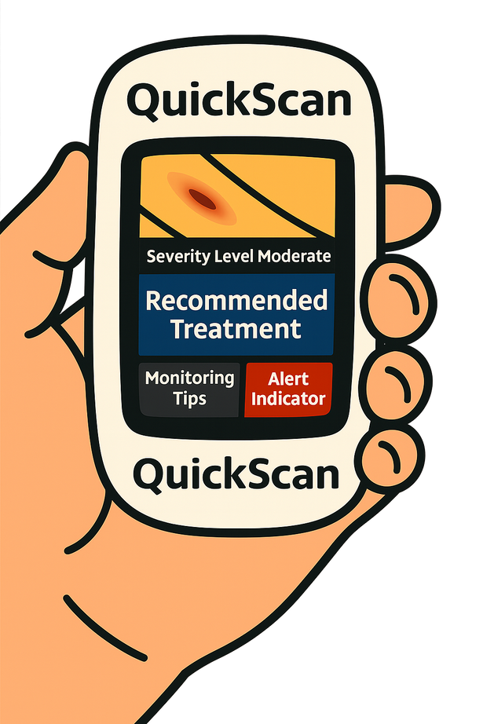

QuickScan-The Handheld Diagnostic Tool
Jamie Steele
T00745105
Thompson Rivers University
HLTH 5500 Integrating IT in Healthcare
Dr Anila Virani

Slide 2
Land Acknowledgement
I acknowledge with gratitude that I live, work, and play on the unceded, ancestral, and traditional territory of the Stó:lō Peoples. I recognize the connection the Stó:lō have to this land, and I am committed to ongoing learning and reflection as I honour their present, past and future.

Slide 3

Overview
  What is the Problem?
  What is QuickScan?
  Part A-Pediatric Population
  Part B-Adults with Chronic Conditions
  Google Search Findings
  Vision for the Future
  Conclusion
  Q & A

Slide 4

The Problem
Emergency departments across Canada are more overcrowded than ever, often due to minor ailments that likely do not require Emergency care.
There appears to be no end in sight to the growing number of patients accessing emergency services, which continues to further strain the Healthcare System.
(Varner, 2023)

Slide 5
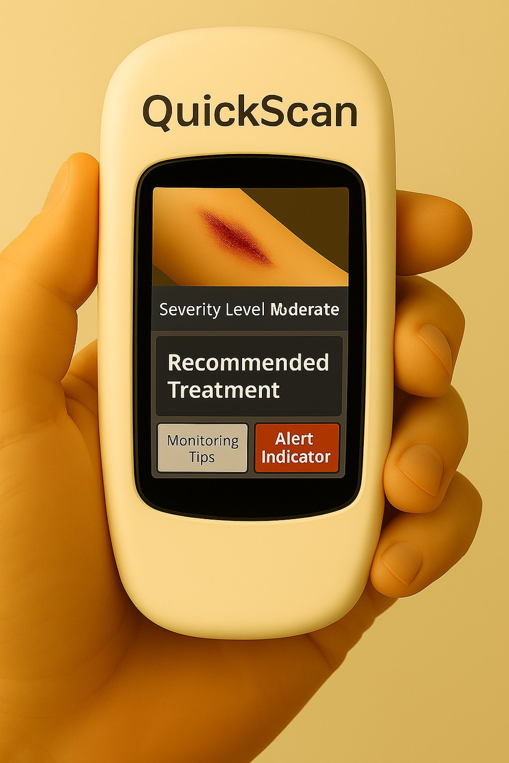
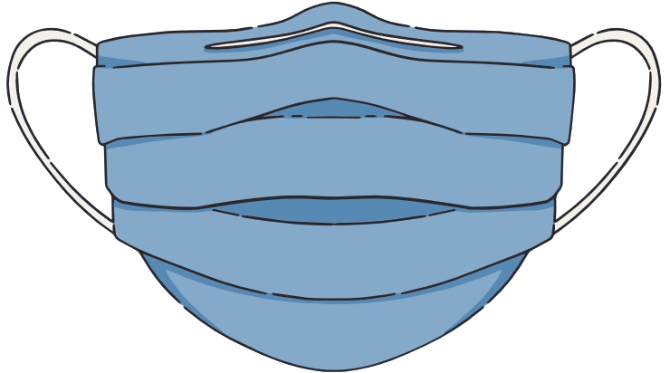

What is QuickScan
  Touchscreen with rear-facing camera, and optional user profiles. It is water-resistant, operates for up to 12 hours on a single charge, and requires a Wi-Fi connection to function.
  Compact, handheld device that uses AI and a built in camera to assess minor to moderate skin injuries.

Slide 6

  Children are naturally curious and often act without thinking about the potential risks.
  Appetite to Play (2017) is a government initiative aimed at encouraging a minimum of 60 minutes of active outdoor play per day for children.
  Parents are trying to strike a balance between keeping their children safe and allowing them to explore the world through play
Part A-Pediatric Population
(Buckler at al., 2023)

Slide 7

Meet the Wilson Family

Slide 8

Part A- Pediatric Population

Slide 9
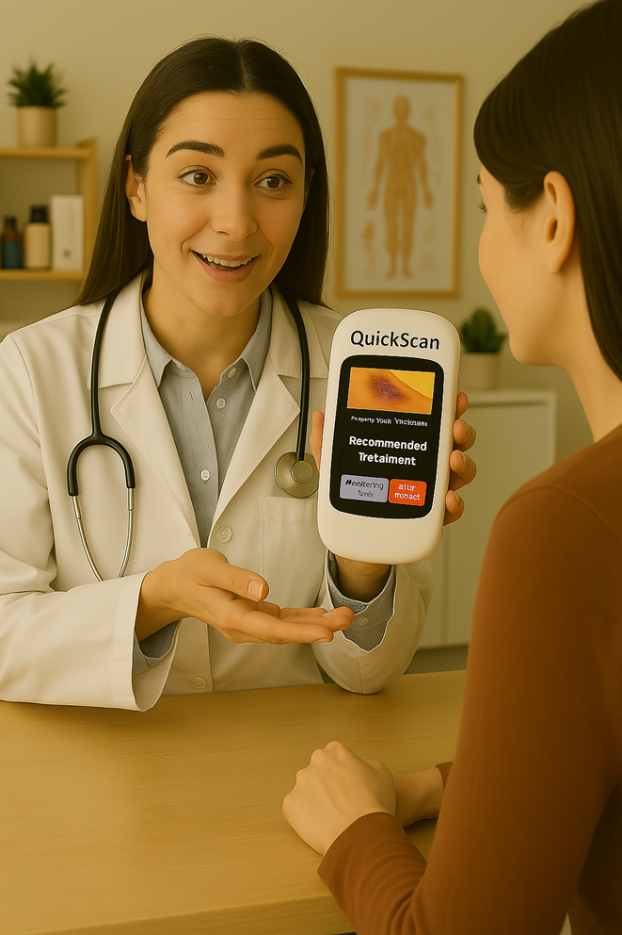
Part A- Pediatric Population

Slide 10
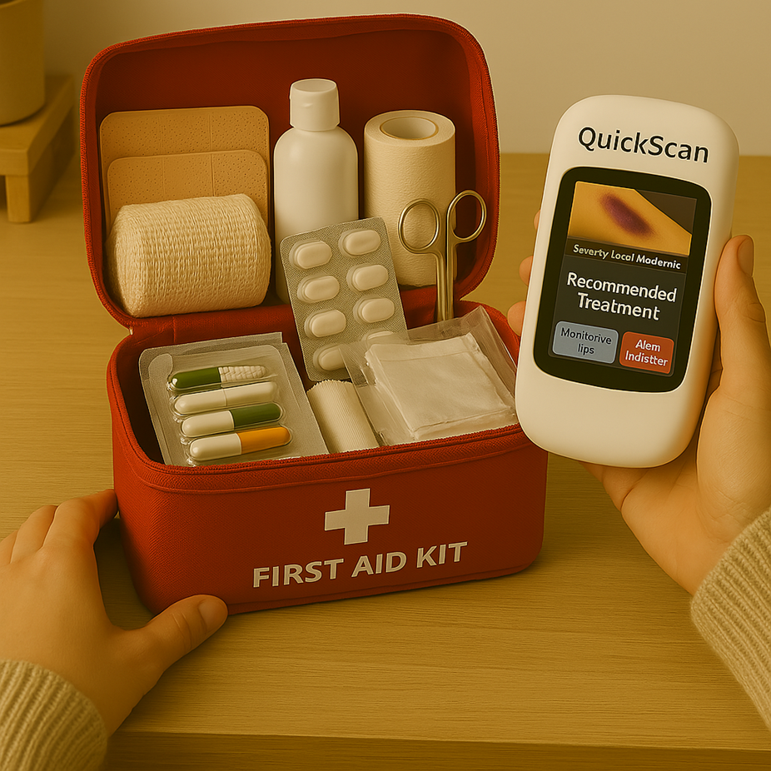
Part A- Pediatric Population

Slide 11
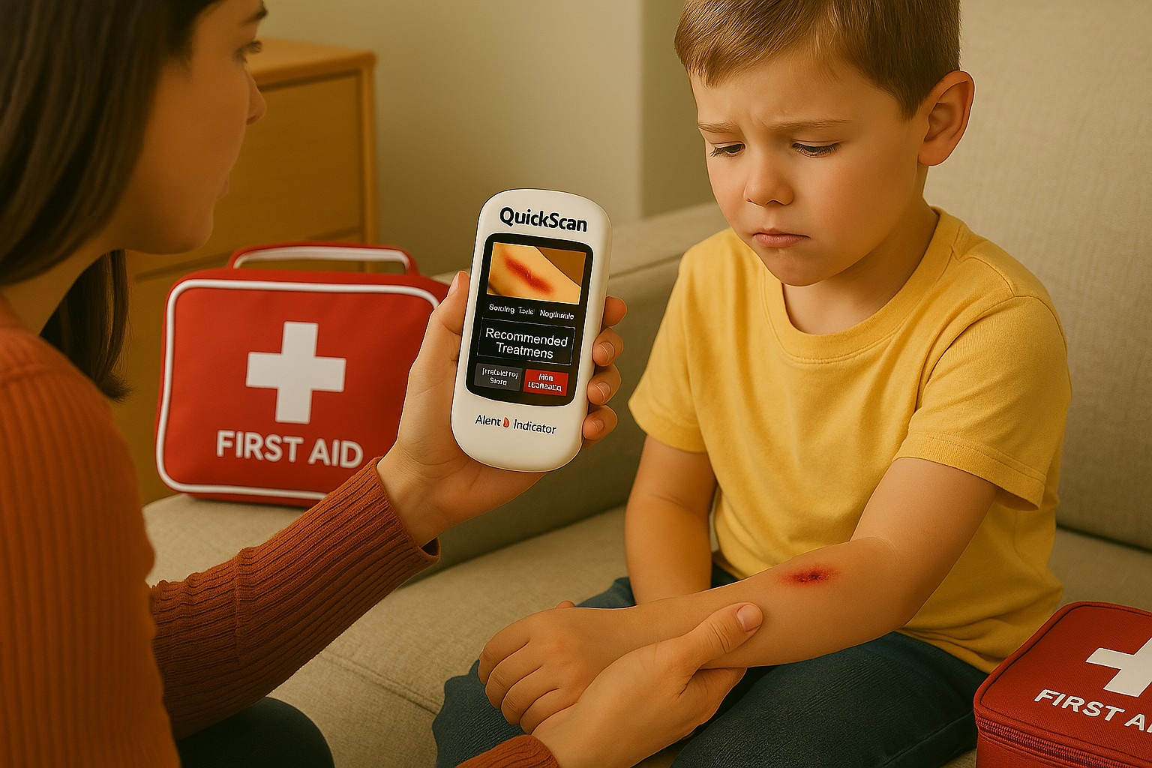
Part A- Pediatric Population

Slide 12
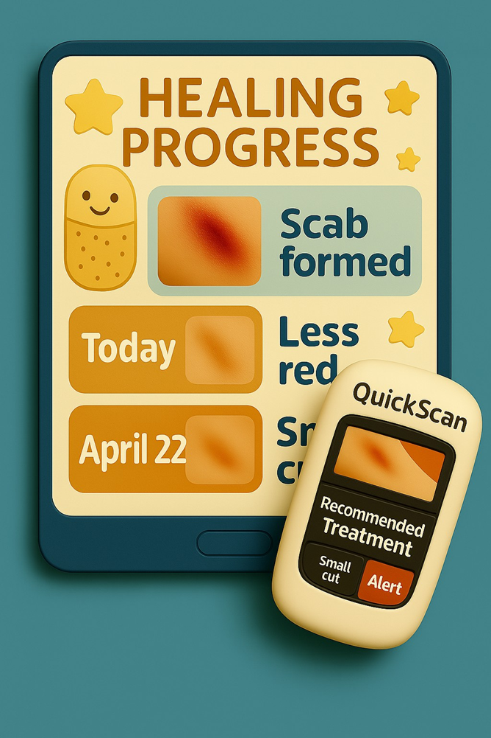
Part A- Pediatric Population

Slide 13
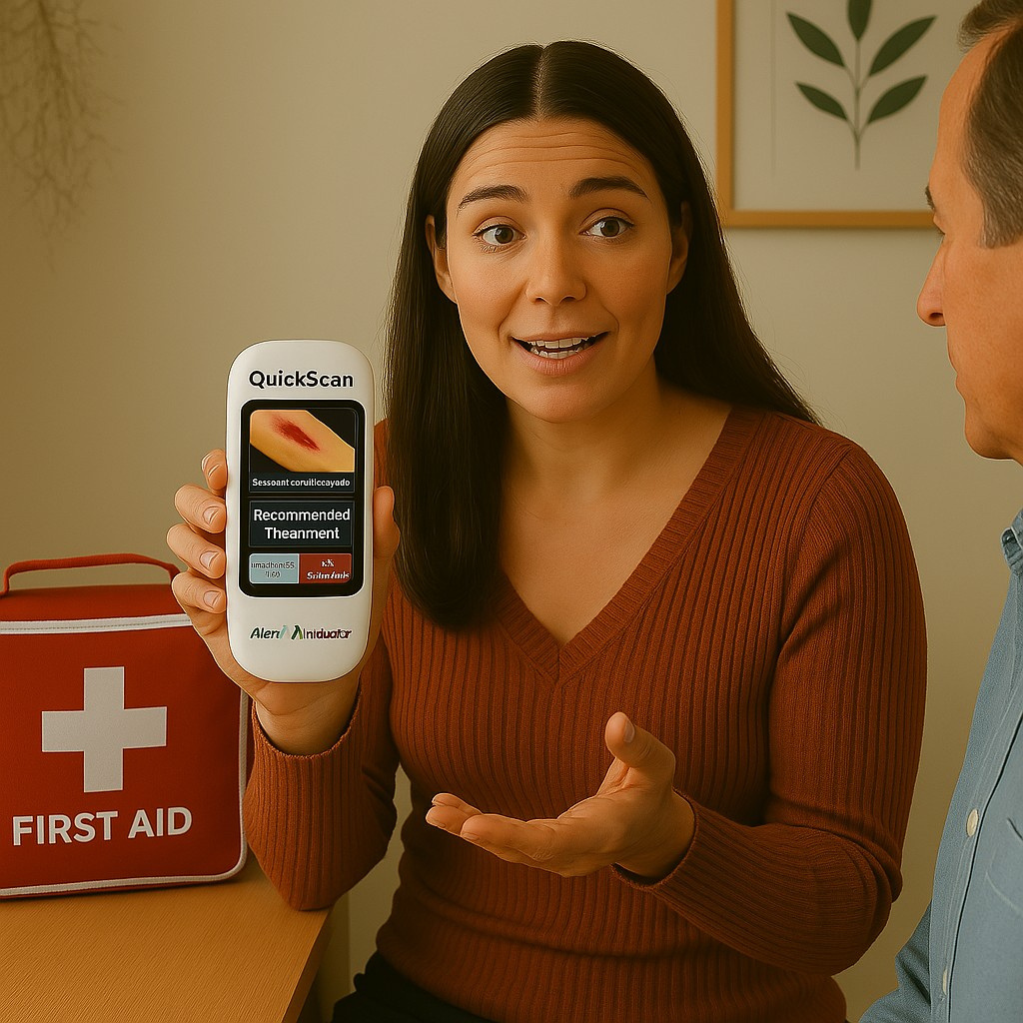
Part A- Pediatric Population

Slide 14
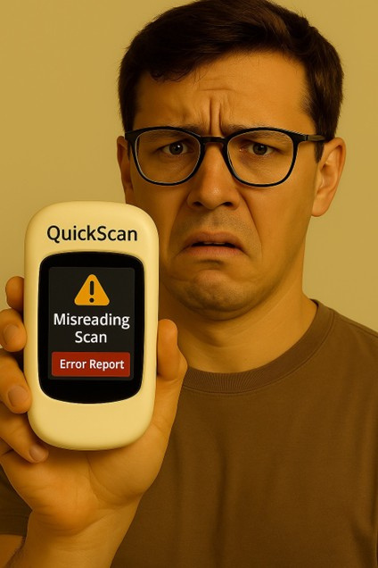
Part A- Pediatric Population

Slide 15
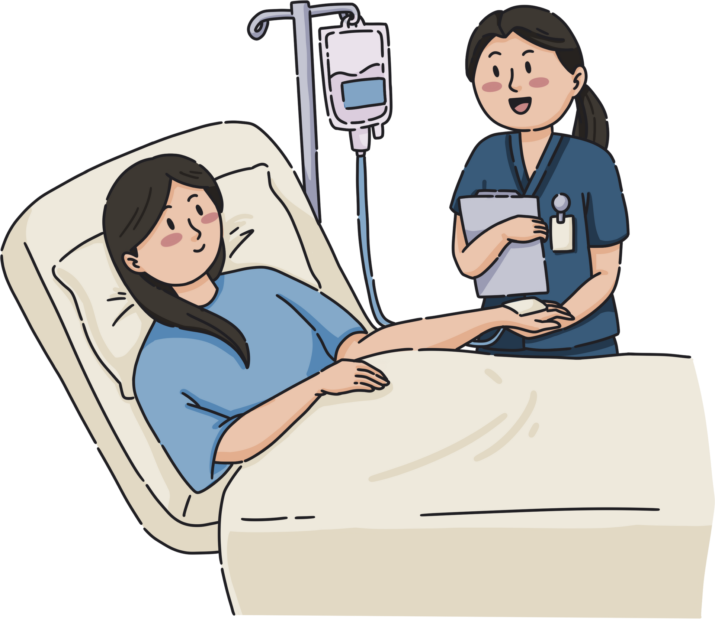
Part B-Adults with Chronic Conditions
  Adults with chronic conditions often experience impaired healing and have increased healthcare needs.
  Multimorbidity was present in 33% of the Canadian study population.
(Geda et al.. 202,, Polanco et al. 2025)

Slide 16

Part B-Adults with Chronic Conditions

Slide 17

Part B-Adults with Chronic Conditions

Slide 18
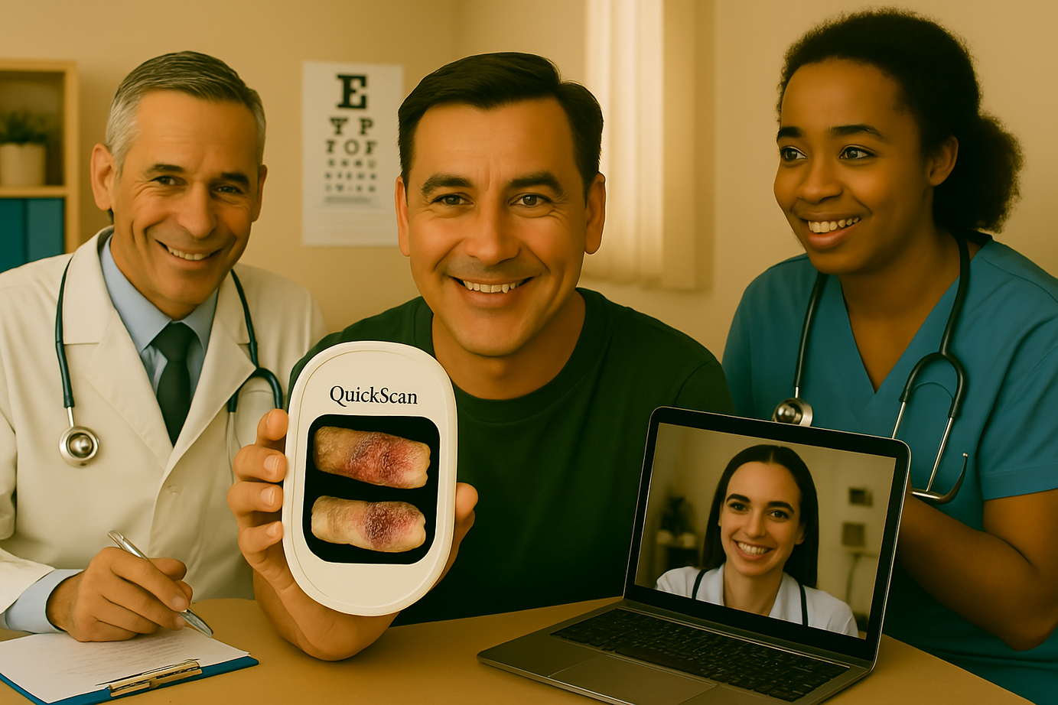
Part B-Adults with Chronic Conditions

Slide 19
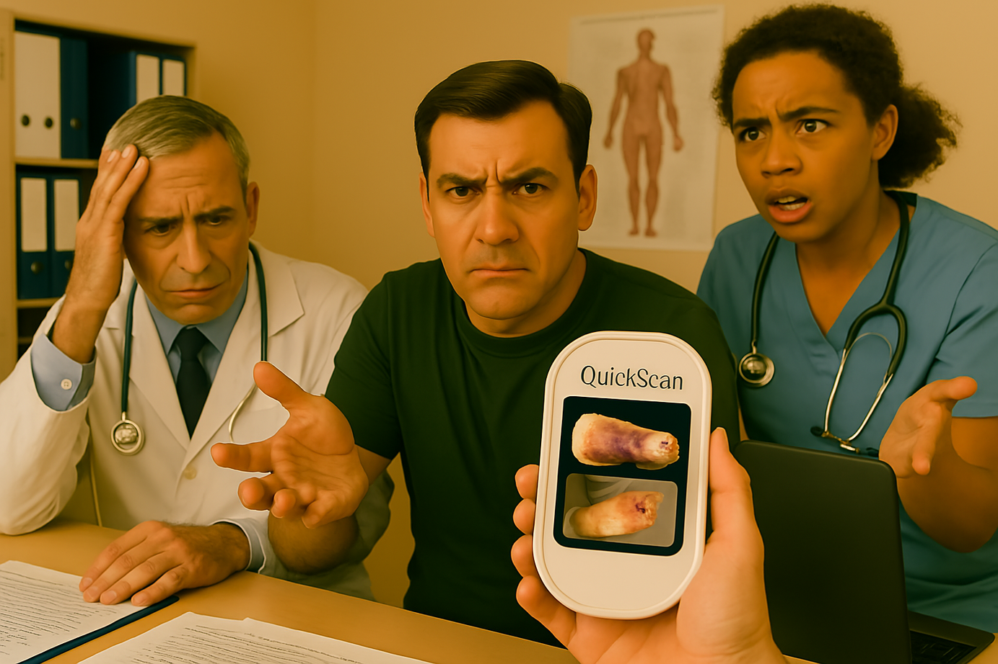
Part B-Adults with Chronic Conditions

Slide 20

Part B-Adults with Chronic Conditions

Slide 21
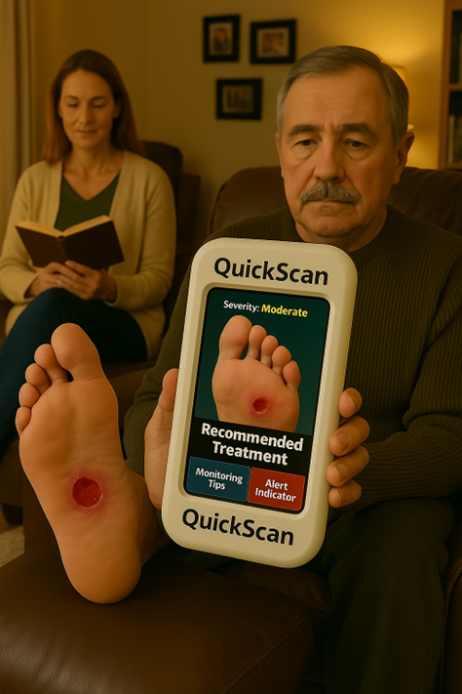
Part B-Adults with Chronic Conditions

Slide 22
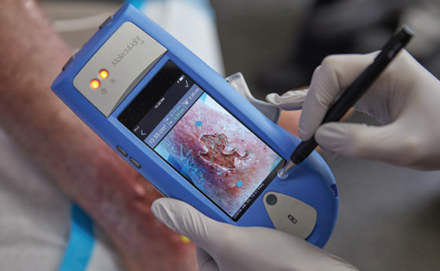
Google Search Results-Pediatric
Population
  MolecuLight: Detects harmful bacteria associated with infections, precisely assesses wound dimensions, and monitors changes in skin temperature.
(MolecuLight, 2025)

Slide 23
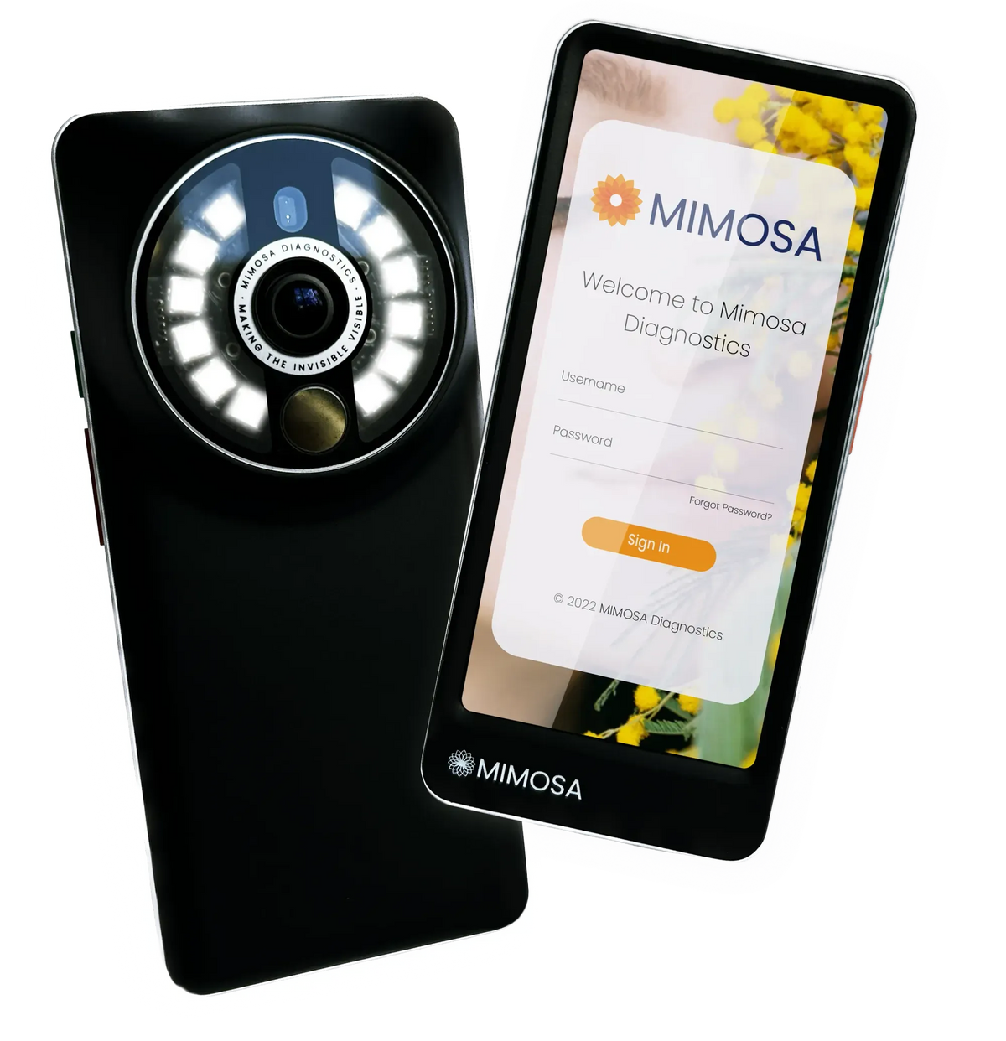
Google Search Results-Adult
Population
  MIMOSA: A handheld tissue scanning device designed for assessing skin integrity and evaluating wound treatment, with images securely uploaded to a protected portal.
(MIMOSA Diagnostics., 2025)

Slide 24
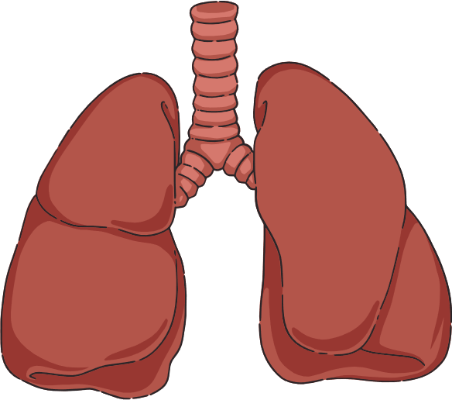


Vision for the Future
  QuickScan to enhance health outcomes in rural communities for individuals with limited access to primary care.
  QuickScan as a versatile tool for more than just skin injuries, including poison ingestion incidents and concussions.

Slide 25

Conclusion

Slide 26
References
Buckler, E. J., Mâsse, L. C., Faulkner, G. E., Puterman, E., McConnell-Nzunga, J., & Naylor, P.-J. (2023). Implementing active play standards: a qualitative study with licensed childcare providers in British Columbia, Canada. Health Promotion International, 38(3), 1–12. https://doi.org/10.1093/heapro/daac036
Geda, N. R., Janzen, B., & Pahwa, P. (2021). Chronic disease multimorbidity among the Canadian population: prevalence and associated lifestyle factors. Archives of Public Health, 79(1), 1–11. https://doi.org/10.1186/s13690-021-00583-7
MIMOSA Diagnostics. (2025). Making the invisible visible. Retrieved from: https://www.mimosadiagnostics.com/
MolecuLight. (2025). Start Seeing Wounds in a New Light. Retrieved from https://moleculight.com/
ProMed Mobile Imaging. (2025). Who We Are. Retrieved from https://www.promedmobileimaging.com/who-we-are

Slide 27
References
Polanco, B., Oña, A., Gemperli, A., & Barzallo, D. P. (2025). Excess healthcare utilization and costs linked to chronic conditions: a comparative study of nine European countries. European Journal of Public Health, 35(2), 216–227. https://doi.org/10.1093/eurpub/ckaf012
Varner, C. (2023). Emergency departments are in crisis now and for the foreseeable future. CMAJ : Canadian Medical Association Journal = Journal de l’Association Medicale Canadienne, 195(24), E851–E852. https://doi.org/10.1503/cmaj.230719

