Slide 1




VITALLINK
COMMUNITY TRIAGE HUB
Technology-Driven Healthcare Solutions Assignment

Slide 2






Land acknowledgement
Thompson Rivers University campuses are on the traditional lands of the Tk’emlúps te Secwépemc (Kamloops campus) and the T’exelc (Williams Lake campus) within Secwépemc’ulucw, the traditional and unceded territory of the Secwépemc. Our region also extends into the territories of the St’át’imc, Nlaka’pamux, Nuxalk, Tŝilhqot’in, Dakelh, and Syilx peoples, on whose on whose traditional territories we are privileged to live, work, and play.

Slide 3





Problem Statement
  Inequitable access to healthcare.
  Overcrowded emergency departments:
  Lack of family physician.
  Geographic and transportation challenges:
  Technology exclusion.
  Healthcare workforce shortage:
VITALLINK

Slide 4

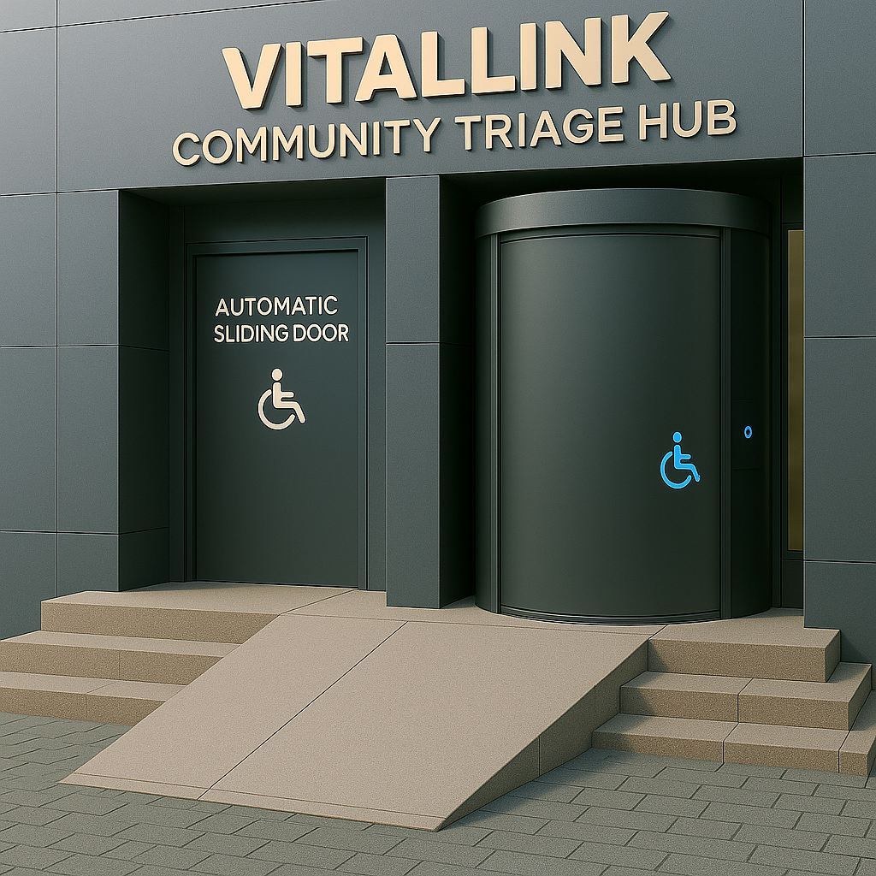

Description of the Novel Idea
The VitalLink Pod is a modular, AI-augmented, community-oriented health access system intended to provide walk-in, language-inclusive triage services in underprivileged areas.
The VitalLink Pod incorporates:
  AI-driven multilingual interaction
  Automated health data recording
  Real-time EHR integration
  Remote human health professional engagement
  On-site navigation by trained community health
aides

Slide 5

Technical Overview of the VitalLink Pod
1. Design and Layout
Each VitalLink Pod is a compact structure, built with reinforced, soundproof materials for privacy. It comprises three core zones:
  Access-Controlled Entry Booth
  Smart Triage Pod with Smart Chair
  Exit and Follow-Up Zone
The pod is climate-controlled, well-lit, wheelchair-accessible, and adheres to privacy regulations such as Canada’s Personal Information Protection and Electronic Documents Act (PIPEDA).

Slide 6
Technical Overview of the VitalLink Pod
2. Multilingual AI Interface
Upon entry, users are greeted by a multilingual AI system that facilitates both voice and screen interaction. The AI offers a selection of over 30 languages, with speech synthesis and recognition functionalities specifically tailored to healthcare communication. This interface is powered by Natural Language Processing (NLP) models trained specifically on healthcare vocabulary in multiple languages.

Slide 7
Technical Overview of the VitalLink Pod
2. Multilingual AI Interface
Patients are prompted to scan their provincial health card (e.g., BC Services Card) to verify identity. For those without an existing profile, the system creates a new record, assigning a unique identifier that can be linked to provincial EHR systems. For returning patients, previous visits are recalled, ensuring continuity of care.

Slide 8
Technical Overview of the VitalLink Pod
4. Vital Sign Collection: Smart Chair and Embedded Sensors
After identity verification, patients are guided to a Smart Chair, which performs a complete set of vital sign assessments within two minutes. These include:
  Blood pressure (via automatic arm cuff)
  Body temperature (infrared scanner)
  Heart rate and rhythm (ECG pads in armrests)
  Blood oxygen saturation (via finger scan)
  Weight and BMI (embedded seat scale and floor sensors)

Slide 9
Technical Overview of the VitalLink Pod
Remote Triage via Secure Video Link
Once vitals are recorded, patients are connected via encrypted video link to a licensed nurse who:
  Reviews vital signs in real time
  Asks basic medical history questions
  Provides a primary assessment and suggests next steps
The nurse may determine that the issue is:
  Non-urgent and manageable at home
  Requiring follow-up at a walk-in clinic
  Urgent and requiring ED referral

Slide 10
Technical Overview of the VitalLink Pod
5. On-Site Care Navigation and Follow-Up
To complete the loop of care, each pod is supported by a rotating team of local health aides. Once a patient’s needs are determined, these aides:
  Print or send digital summaries to nearby clinics
  Accompany patients to local services if required
  Schedule follow-up appointments or referrals
  Provide printed instructions in the patient’s preferred language

Slide 11


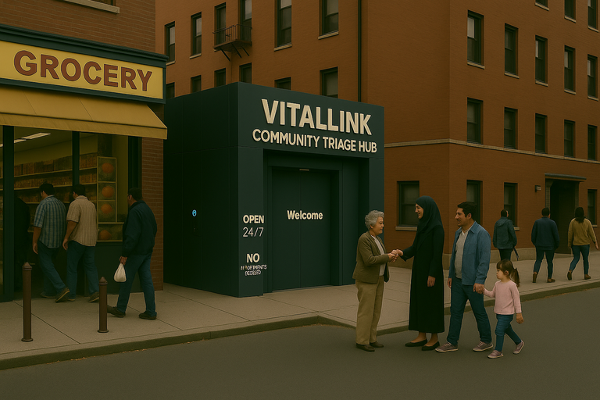
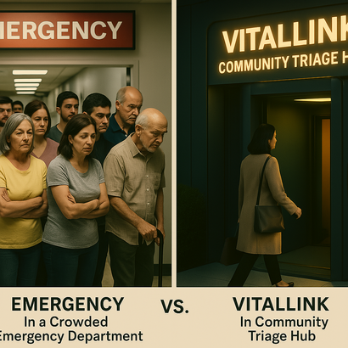
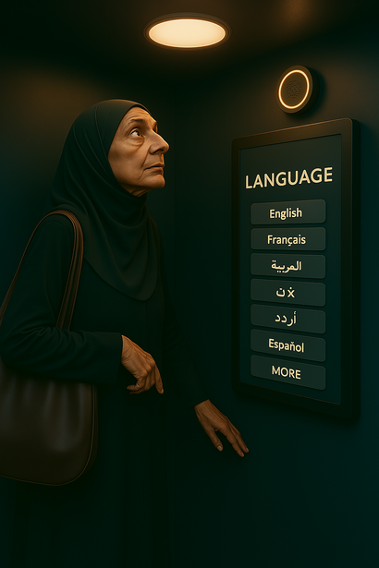

Benefits
  Increases Access to Care for Underserved Populations
  Streamlines Patient Flow and Reduces Wait Times
  Integrates Multilingual, Culturally Sensitive Care
  Enhances Healthcare Workforce Efficiency
  Supports Real-Time Health Data Collection and EHR Integration

Slide 12
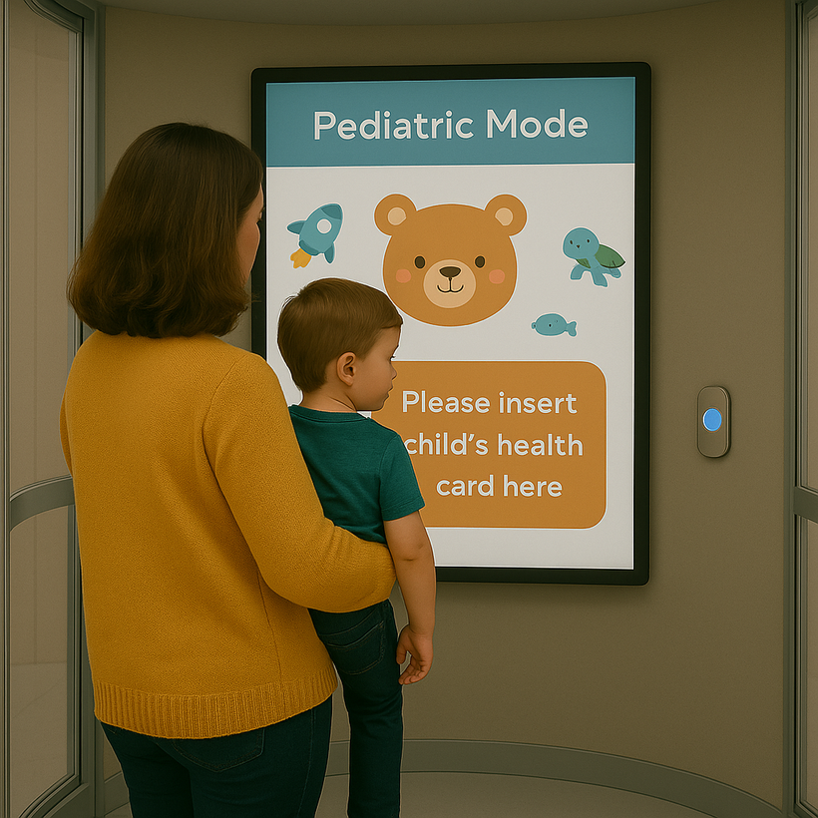


Noah’s
Story.

Slide 13
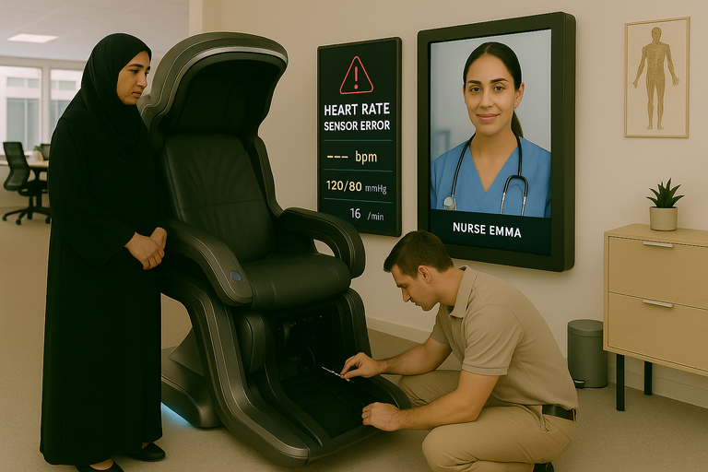
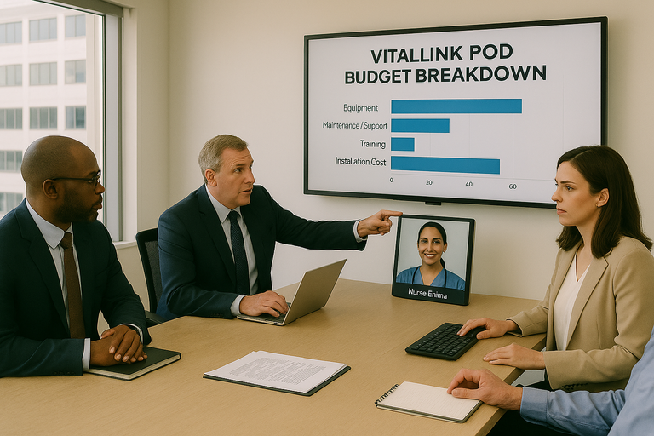

Challenges
  Upfront Infrastructure and Implementation Costs
  Patient Trust and Digital Literacy Concerns
  Technical Malfunctions or Sensor Inaccuracies
  Data Security and Privacy Risks
  Limited Scope Without In-Person Diagnostics

Slide 14

VITALLINK
Google Search Documentation and Analysis
What Exists:
  Babylon Telus: Offers app-based virtual consultation, but no walk-in pod or multilingual triage tools.
  OnMed Station (U.S.): Kiosk with virtual care, but not present in BC and lacks pediatric or multilingual interfaces.
  Well Health: Offers EMR tools and virtual consults but no physical pods or AI triage features.

Slide 15


Conclusion.

Slide 16
THANK YOU!
FOR LISTENING.

Slide 17
References.
Basu, G., Costa, V. P., & Jain, P. (2017). Clinicians’ obligations to use qualified medical interpreters when caring for patients with limited English proficiency. AMA Journal of Ethics, 19(3), 245–252. https://doi.org/10.1001/journalofethics.2017.19.3.ecas2-1703
Canadian Institute for Health Information. (2022). Emergency department wait times: Long stays and increased acuity. https://www.cihi.ca/en/emergency-department-wait-times
CityNews Montreal. (2024, November 25). Canada’s first telehealth station unveiled in Montreal’s West Island. https://montreal.citynews.ca/2024/11/25/canada-first-telehealth-station-montreal-west-island/
CloudMD Software & Services Inc. (2020, May 4). CloudMD and Save-On-Foods partner to pilot on-demand virtual patient care by integrating telemedicine kiosks in pharmacies. https://www.globenewswire.com/news-release/2020/05/04/2026642/0/en/CloudMD-and-Save-On-Foods-Partner-to-Pilot-On-Demand-Virtual-Patient-Care-by-Integrating-Telemedicine-Kiosks-in-Pharmacies.html
Clove, D. (2023). Healthcare access disparities among rural populations in the United States. Ballard Brief, 2023(1), Article 5. https://scholarsarchive.byu.edu/ballardbrief/vol2023/iss1/5
Dimakou, S., Dimakou, O., & Basso, H. S. (2015). Waiting time distribution in public health care: Empirics and theory. Health Economics Review, 5(25). https://doi.org/10.1186/s13561-015-0061-7
Greenhalgh, T., Shaw, S. E., Alvarez Nishio, A., Byng, R., Clarke, A., Dakin, F., Faulkner, S., Hemmings, N., Husain, L., Kalin, A., Ladds, E., Moore, L., Rosen, R., Rybczynska-Bunt, S., Wherton, J., & Wieringa, S. (2022). Remote care in UK general practice: Baseline data on 11 case studies [version 2; peer review: 2 approved]. NIHR Open Research, 2, 47. https://doi.org/10.3310/nihropenres.13290.2
Infermedica. (2023, December 13). Infermedica expands global reach with support for 24 languages on AI-powered medical guidance platform. https://www.prnewswire.com/news-releases/infermedica-expands-global-reach-with-support-for-24-languages-on-ai-powered-medical-guidance-platform-302013606.html
Kelen, G. D., Wolfe, R., D’Onofrio, G., Mills, A. M., Diercks, D., Stern, S. A., Wadman, M. C., & Sokolove, P. E. (2021). Emergency department crowding: The canary in the health care system. NEJM Catalyst Innovations in Care Delivery. https://doi.org/10.1056/CAT.21.0217
Kontos, E., Blake, K. D., Chou, W. Y. S., & Prestin, A. (2014). Predictors of eHealth usage: Insights on the digital divide from the Health Information National Trends Survey 2012. Journal of Medical Internet Research, 16(7), e172. https://doi.org/10.2196/jmir.3117
LanguageLine Solutions. (2020, October 6). Kiosks are bringing language access to self-service technology. https://www.languageline.com/blog/kiosks-are-bringing-language-access-to-self-service-technology
MacKichan, F., Brangan, E., Wye, L., Checkland, K., Lasserson, D., Huntley, A., Morris, R., Tammes, P., Salisbury, C., & Purdy, S. (2017). Why do patients seek primary medical care in emergency departments? An ethnographic exploration of access to general practice. BMJ Open, 7, e013816. https://doi.org/10.1136/bmjopen-2016-013816
Microsoft Corporation. (2025). [AI-generated clinic environment images for the VitalLink Pod project]. Copilot in Microsoft 365. https://www.microsoft.com/en-us/microsoft-365/copilot
NHS England & NHS Improvement. (2020). A&E attendances and emergency admissions monthly return definitions (Version 5.0). https://www.england.nhs.uk/statistics/statistical-work-areas/ae-waiting-times-and-activity/
OnMed. (2024, January 5). Hartford HealthCare & OnMed launch new healthcare experience Connecticut. https://www.onmed.com/resources/hartford-healthcare-onmed-launch-new-healthcare-experience-connecticut
PharmaSmart International LLC. (2021, August 17). PharmaSmart blood pressure kiosks recognized on US Validated Device List (VDL™). https://www.newswire.ca/news-releases/pharmasmart-blood-pressure-kiosks-recognized-on-us-validated-device-list-vdl-tm–894654011.html
Squires, A. (2018). Strategies for overcoming language barriers in healthcare. Nursing Management (Springhouse), 49(4), 20–27. https://doi.org/10.1097/01.NUMA.0000531166.24481.15
Teslon Technologies. (n.d.). Carenation kiosk – Teslon. https://teslon.io/carenation-kiosk/
Topol, E. (2019). Deep medicine: How artificial intelligence can make healthcare human again. Basic Books.
UniDoc Health Corp. (2024, November 6). UniDoc ships first AI-equipped H3 Health Cubes to commercial customers. https://unidoctor.com/unidoc-ships-first-ai-equipped-h3-health-cubes-to-commercial-customers/
Urbach, D. R. (2018). Improving access to health services in Canada. Healthcare Management Forum, 31(6), 243–246. https://doi.org/10.1177/0840470418776995
Whittaker, W., Anselmi, L., Kristensen, S. R., Lau, Y.-S., Bailey, S., Bower, P., Checkland, K., Elvey, R., Rothwell, K., Stokes, J., & Hodgson, D. (2016). Associations between extending access to primary care and emergency department visits: A difference-in-differences analysis. PLOS Medicine, 13(9), e1002113. https://doi.org/10.1371/journal.pmed.1002113
World Health Organization. (2023). Universal health coverage (UHC). https://www.who.int/news-room/fact-sheets/detail/universal-health-coverage-(uhc)

